Slide 1
Open-Source Industrial Control
Turning 2,800 Tons of Metal with Python and Flask

Slide 2


Jacob Lapenna
Electrical Engineer at the U.S. Bureau of Reclamation
I design and build cyber-physical systems
LinkedIn
Email (burner)

Slide 3
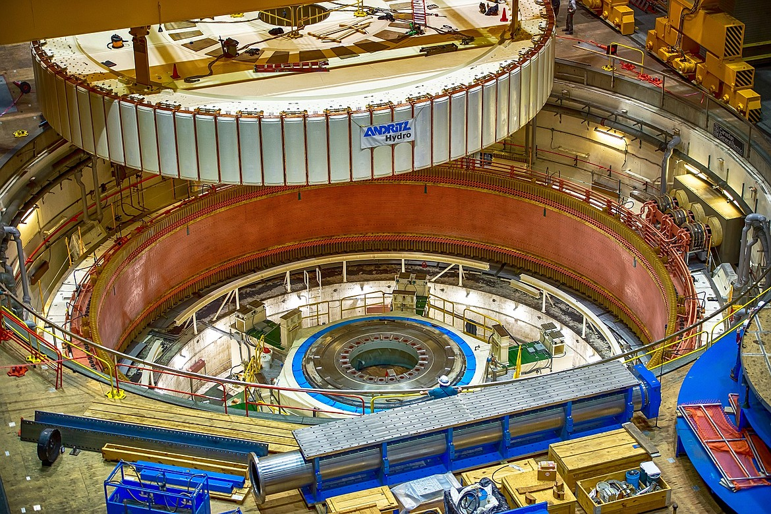
Rotating Machines

Slide 4
Rotating Machines
Notes:
Humans for scale. The turning part of this machine weighs 2,800 tons (2,540,117 kg). The drive shaft is the size of a Redwood tree. This machine has been turned with the methods described in this presentation.

Slide 5
Rotating Machines
The rest is just scale and optimization
S
N
S
N
S
N
S
N
S
N
S
N
Notes:
Rotor = the turning magnets
Stator = the stationary winding
Pole = magnetic pole, commonly referred to as north or south poles of a magnet
The rotor turns and moves magnets past the coils formed by the stator winding. The changing magnetic field induces voltage and current flows to the electric grid.

Slide 6
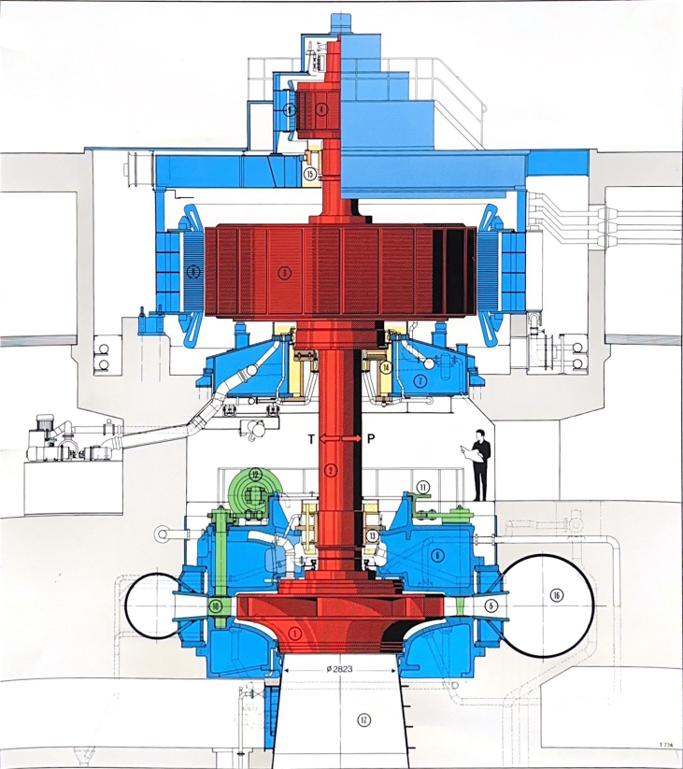
Slow-Roll Testing
We need slow, precise turning for:
Bearing alignment
Signal mapping

Slide 7
Slow-Roll Testing
We need slow, precise turning for:
Bearing alignment
Signal mapping

Slide 8
Slow-Roll Testing
We need slow, precise turning for:
Bearing alignment
Signal mapping

Slide 9
Slow-Roll Testing
How?

Slide 10

Slow-Roll Testing
How?

Slide 11
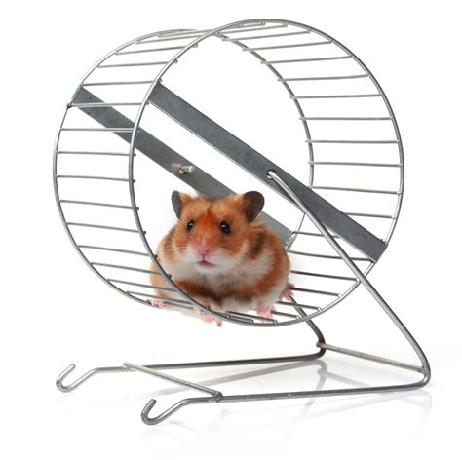
Slow-Roll Testing
How?

Slide 12
Slow-Roll Testing
How?

Slide 13
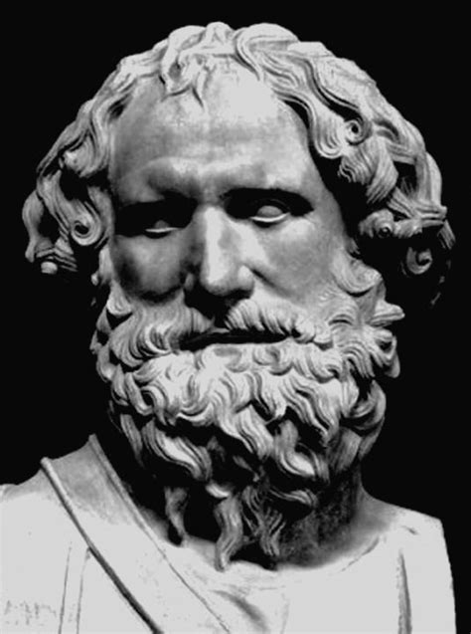
Industrial Control
Give me a relay contact and I can move the world…
Notes:
Archimedes

Slide 14
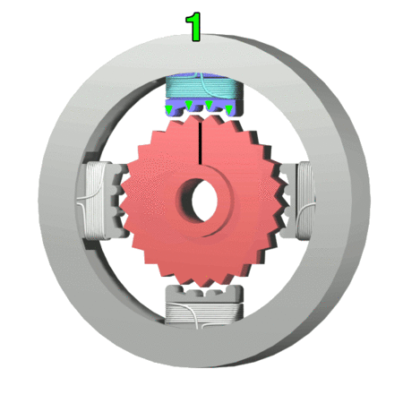
DC Stepper Motor
Notes:
DC = direct current
DC stepper motor = motor that rotates continuously from a continuous series of steps
Electromagnet = magnet formed by sending current through a loop of wire looped around an iron core

Slide 15

DC Stepper Motor

Slide 16
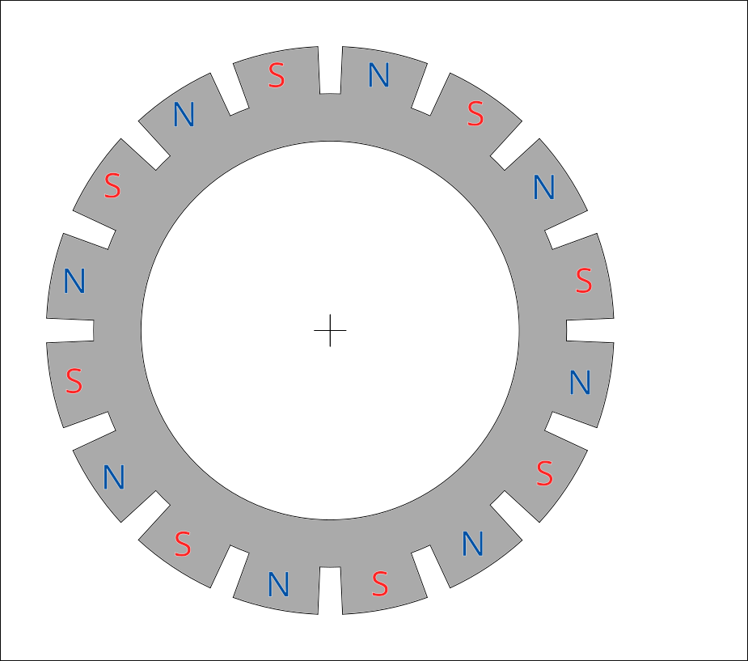
DC Stepper Motor

Slide 17
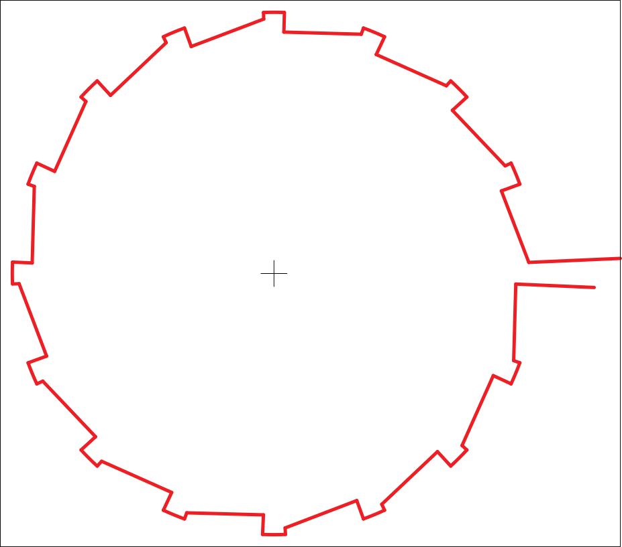
DC Stepper Motor
Notes:
Phase = one circuit of a three circuit (3-phase) system. Our electrical grid runs on 3-phase power, this lets return current return on another phase rather than requiring neutral wire to run across the country.

Slide 18
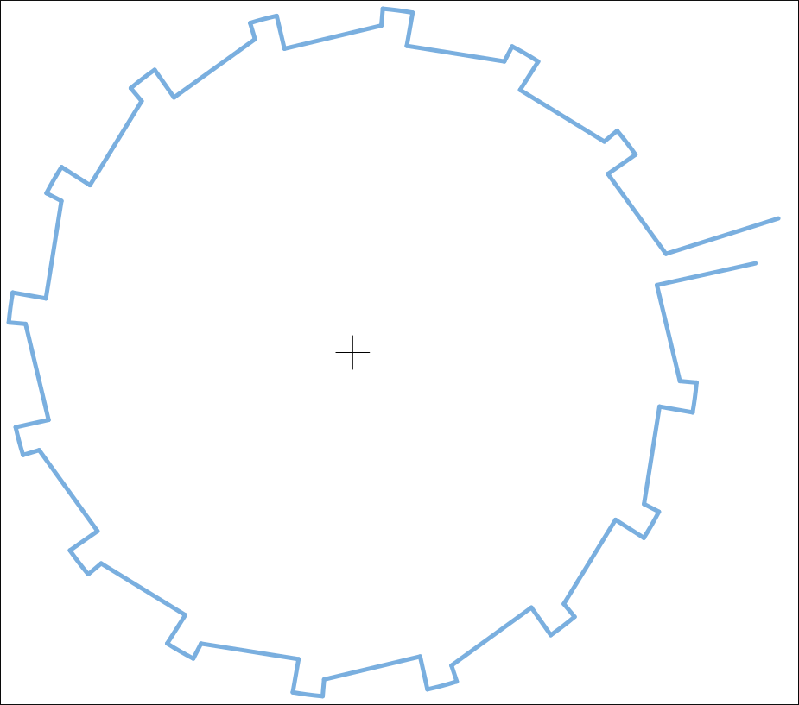
DC Stepper Motor

Slide 19
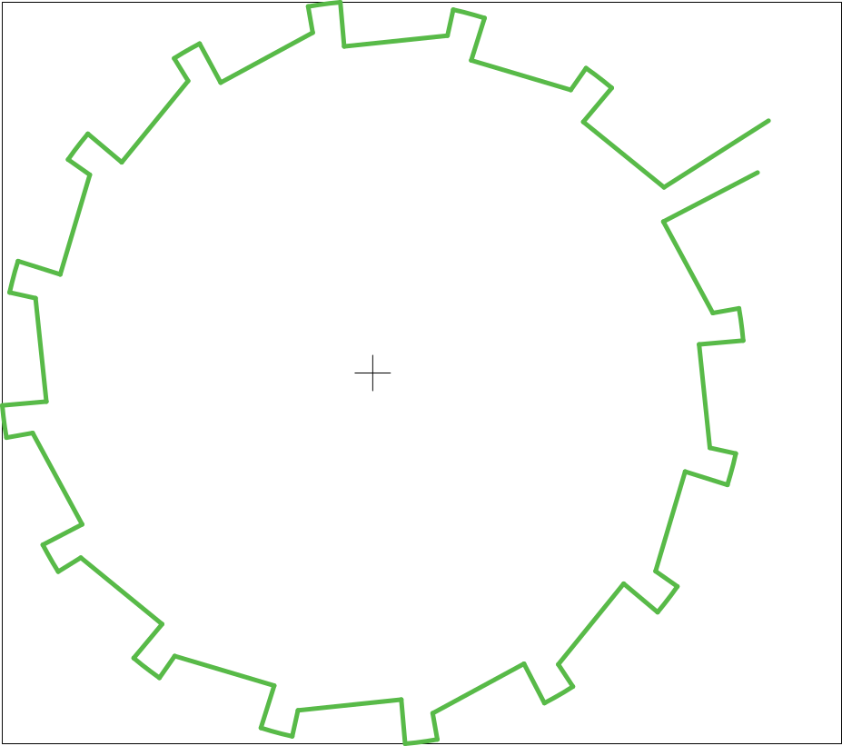
DC Stepper Motor
Notes:
Three phases
Red phase
Blue phase
Green phase

Slide 20
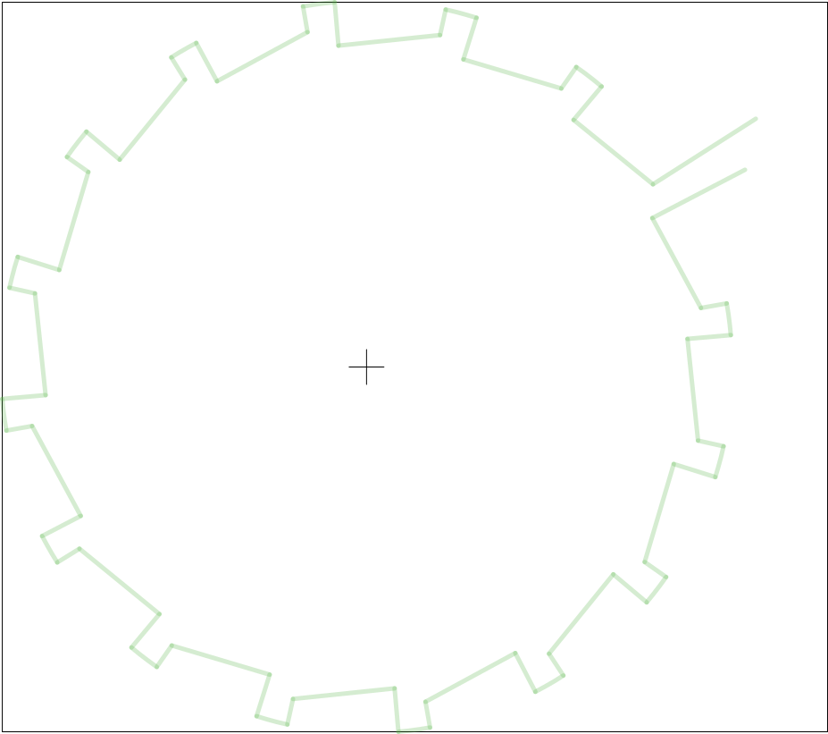

DC Stepper Motor
N
S
S
N
N
S
S
N
I
N
S
S
N
N
S
S
N
Notes:
Torque = rotational force
Force is parallel to the radius, no torque

Slide 21
DC Stepper Motor
S
N
N
S
S
N
N
S
I
S
N
N
S
S
N
N
S
Notes:
Reverse current, swap magnetic poles, north becomes south and south becomes north
Force is again parallel to the radius, no torque

Slide 22
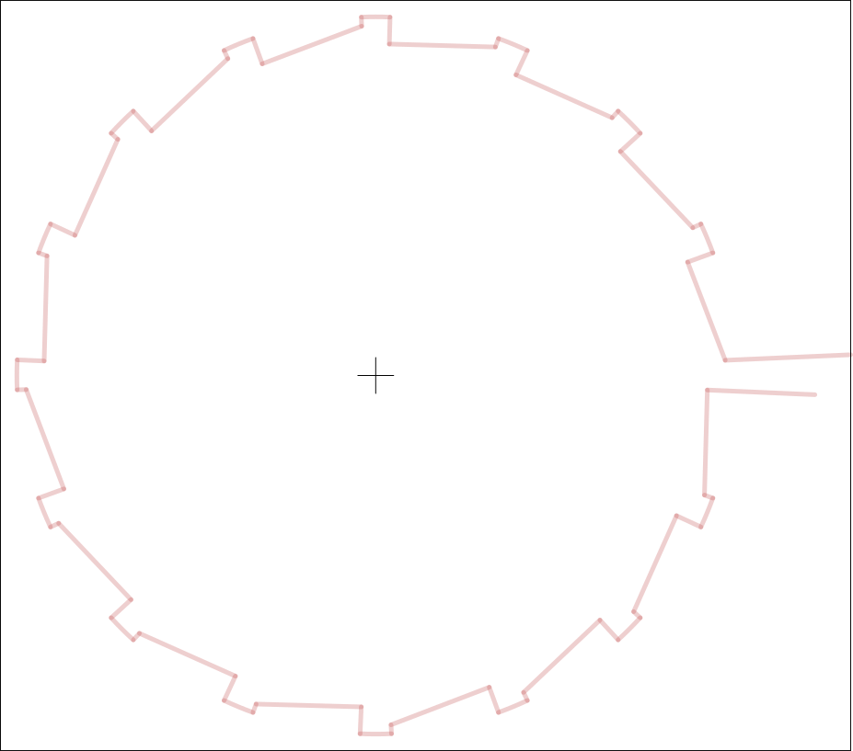
DC Stepper Motor
S
N
N
S
S
I
N
N
S
S
N
N
S
S
N
N
S
Notes:
Apply current to a different phase not already aligned to produce non-zero torque

Slide 23
DC Stepper Motor
S
N
N
S
S
I
N
N
S
S
N
N
S
S
N
N
S

Slide 24
DC Stepper Motor
N
S
S
N
I
N
S
S
N
N
S
S
N
N
S
S
N

Slide 25
DC Stepper Motor
N
S
S
N
I
N
S
S
N
N
S
S
N
N
S
S
N
Notes:
Apply current in the other direction to get torque in the other direction

Slide 26
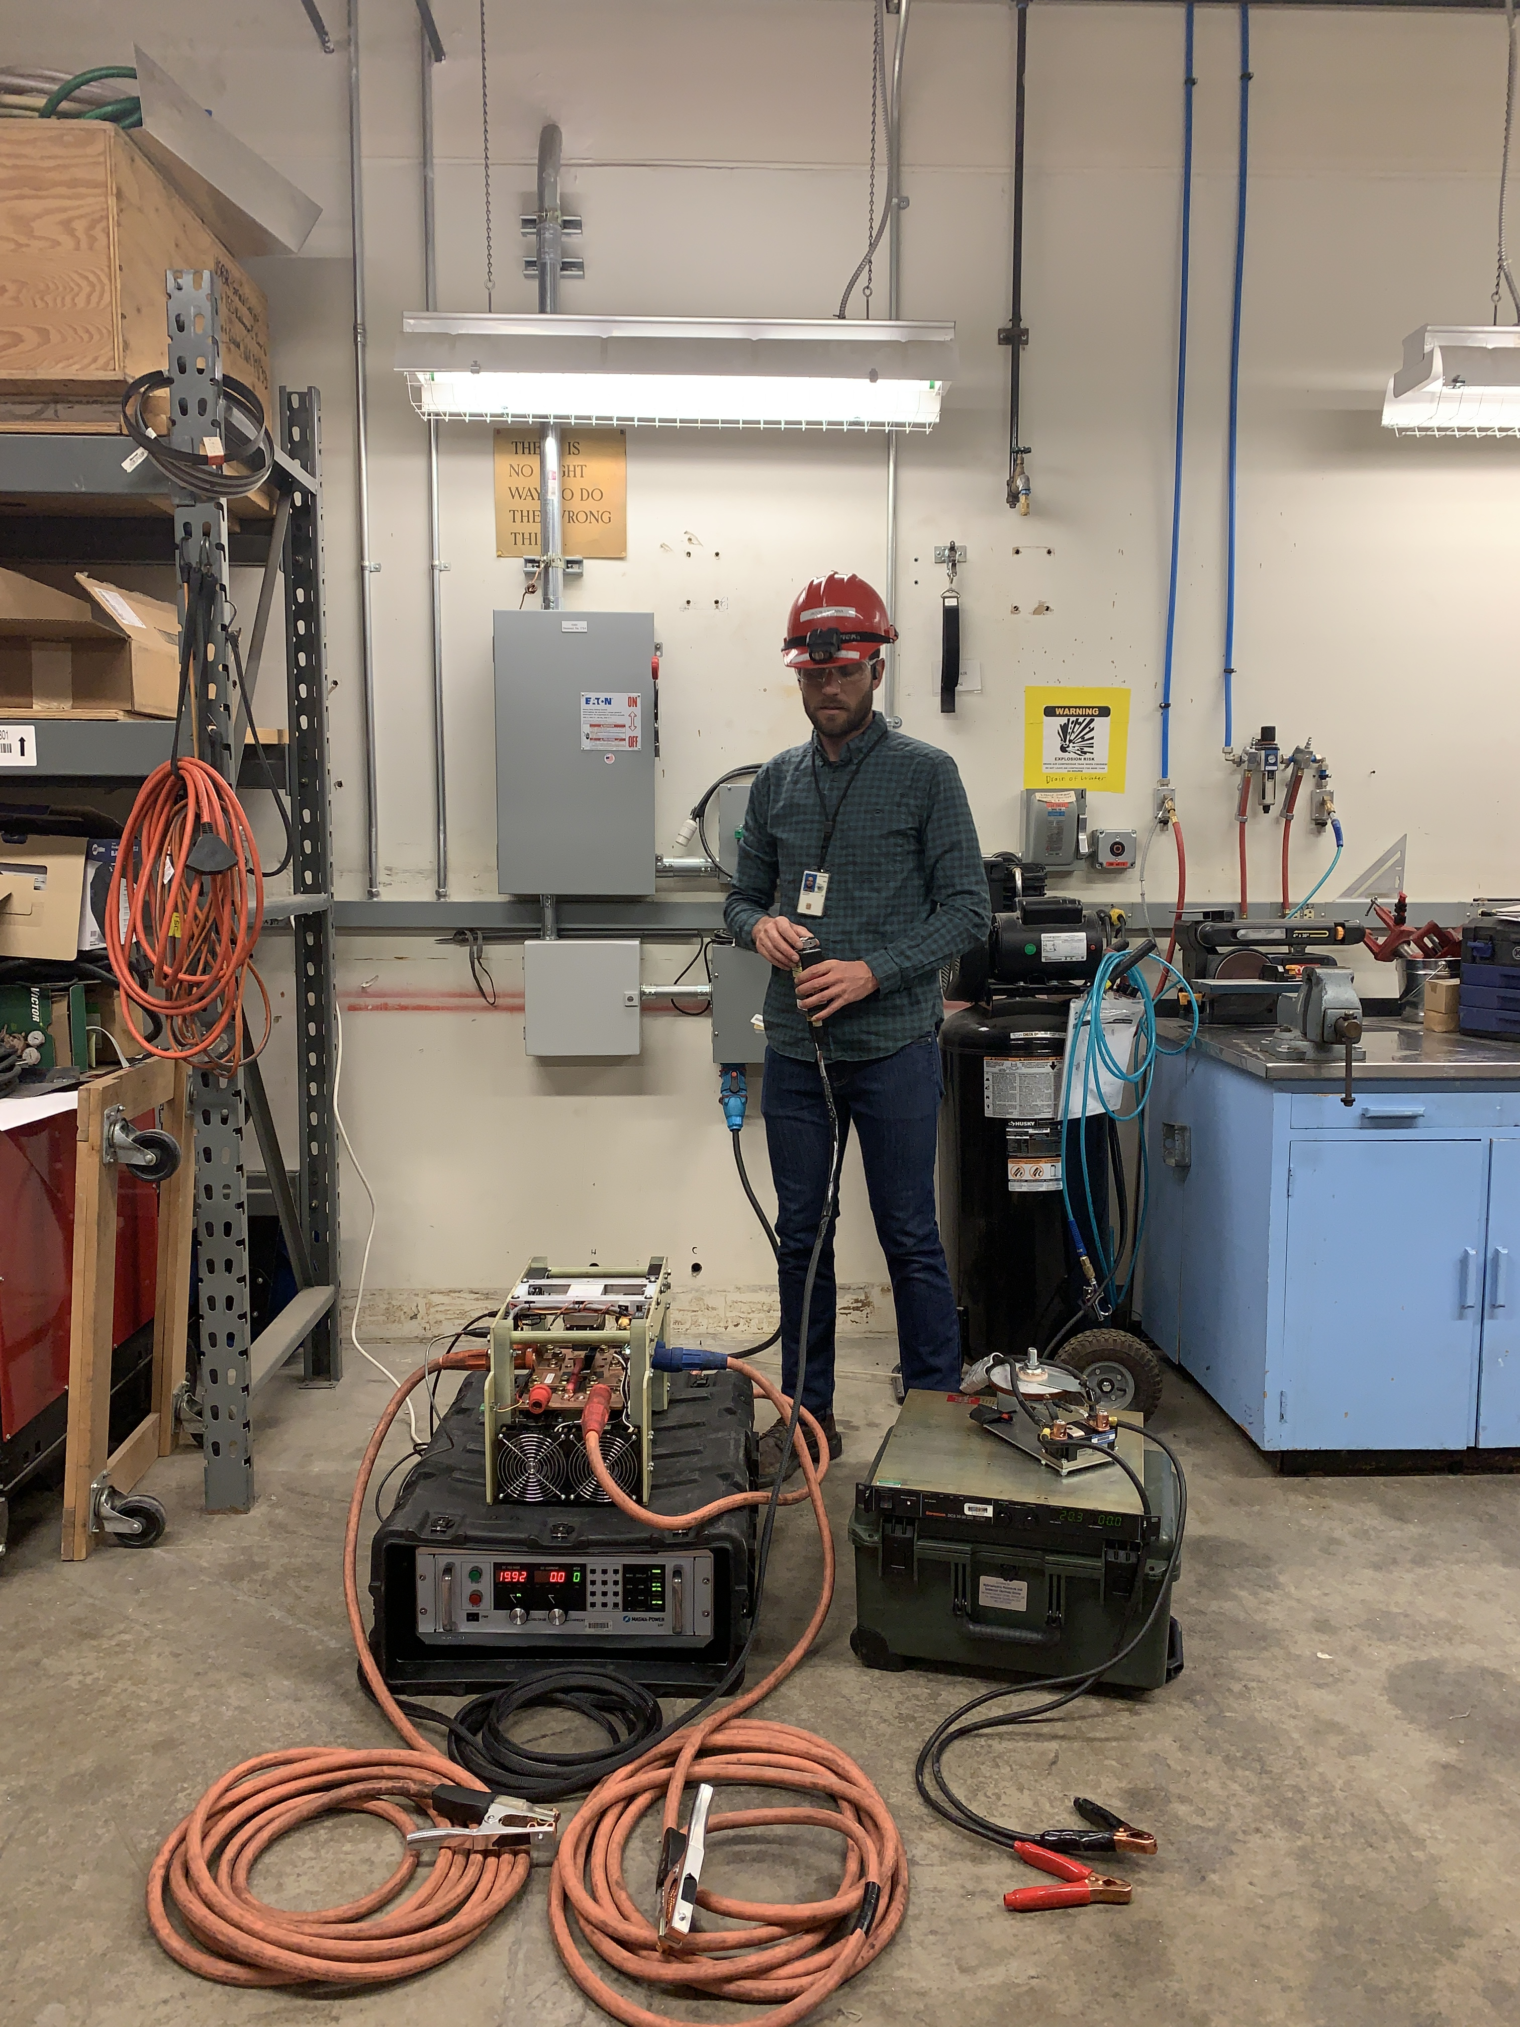
Prototype (2020)
Small power supply for rotor
Large power supply for stator
Current reverser
Manual switch controller

Slide 27
Prototype (2020)
Small power supply for rotor
Large power supply for stator
Current reverser
Manual switch controller
Notes:
Power supply

Slide 28
Prototype (2020)
Small power supply for rotor
Large power supply for stator
Current reverser
Manual switch controller

Slide 29
Prototype (2020)
Small power supply for rotor
Large power supply for stator
Current reverser
Manual switch controller

Slide 30
Prototype (2020)
Small power supply for rotor
Large power supply for stator
Current reverser
Manual switch controller

Slide 31
Prototype (2020)
Small power supply for rotor
Freewheel diode
Large power supply for stator
Current reverser
Manual switch controller
Drawbacks
Specialized & hard to use
Only visual positioning
Not very modular

Slide 32
Prototype (2020)
Small power supply for rotor
Freewheel diode
Large power supply for stator
Current reverser
Manual switch controller
Drawbacks
Specialized & hard to use
Only visual positioning
Not very modular

Slide 33
Prototype (2020)
Small power supply for rotor
Freewheel diode
Large power supply for stator
Current reverser
Manual switch controller
Drawbacks
Specialized & hard to use
Only visual positioning
Not very modular

Slide 34








Python + Raspberry Pi
Notes:
Flask
Flask-SocketIO
Scoket.IO
Celery
Redis
I2C
Digilent
Python
Raspberry Pi (CM4 model)

Slide 35
Browser Application
Why browser-based industrial control?
Plaintext
No installation/Sandboxed
Reduced training
Proven
Creative visualization
Highly interactive
Support
Scalable

Slide 36

Browser Application
Why browser-based industrial control?
Plaintext
No installation/Sandboxed
Reduced training
Proven
Interactive visualization
Support
Scalable
Notes:
Human readable version tracking without procurement of extra proprietary software.

Slide 37

Browser Application
Why browser-based industrial control?
Plaintext
No installation/Sandboxed
Reduced training
Proven
Interactive visualization
Support
Scalable
Notes:
Government furnished equipment, security, etc.

Slide 38

Browser Application
Why browser-based industrial control?
Plaintext
No user installation
Reduced training
Proven
Interactive visualization
Support
Scalable
Notes:
Everyone know how to use a browser. It’s intuitive at this point.

Slide 39

Browser Application
Why browser-based industrial control?
Plaintext
No installation/Sandboxed
Reduced training
Proven
Interactive visualization
Support
Scalable
Notes:
The internet and its underlying technology is incredibly user tested, proven, and well backed.

Slide 40

Browser Application
Why browser-based industrial control?
Plaintext
No installation/Sandboxed
Reduced training
Proven
Interactive visualization
Support
Scalable

Slide 41
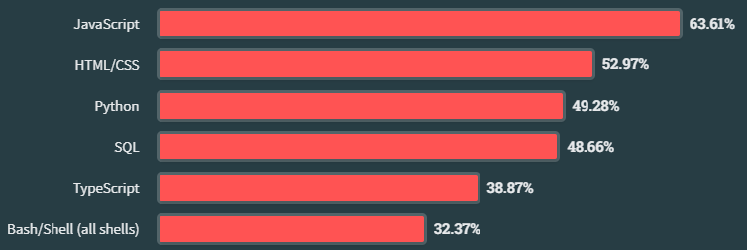
Browser Application
Why browser-based industrial control?
Plaintext
No installation/Sandboxed
Reduced training
Proven
Interactive visualization
Support
Scalable
Notes:
Easier to hire for (vs traditional SCADA). From going to space to automatic cat feeders, Raspberry Pi may be one of the most used and abused pieces of hardware in the world. Also, NASA has even published a “Raspberry Pis for Space Guideline”.

Slide 42
Browser Application
Why browser-based industrial control?
Plaintext
No installation/Sandboxed
Reduced training
Proven
Interactive visualization
Support
Scalable
Notes:
Celery makes task distribution and scaling easy

Slide 43
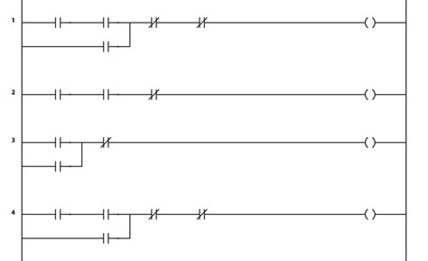
Browser Application
Con: not truly real-time (but so what)
Notes:
Ladder logic = type of visual programing commonly used in PLCs
PLC = programmable logic controller (the typical device used for industrial control)
Real-time operating system = operating system that makes promises on tasks completed in a certain amount of time.

Slide 44




Browser Application
The Cloud / Internet
Security (air gap)
Notes:
Air gap = network that is not physically or wirelessly connected to larger networks like the internet and “the cloud”.

Slide 45
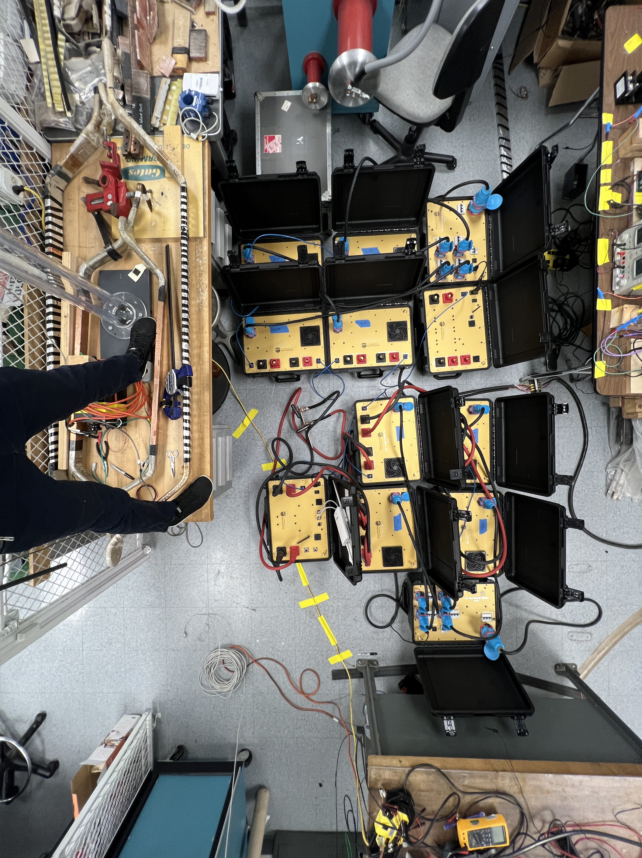
Modular Design (Hardware)

Slide 46
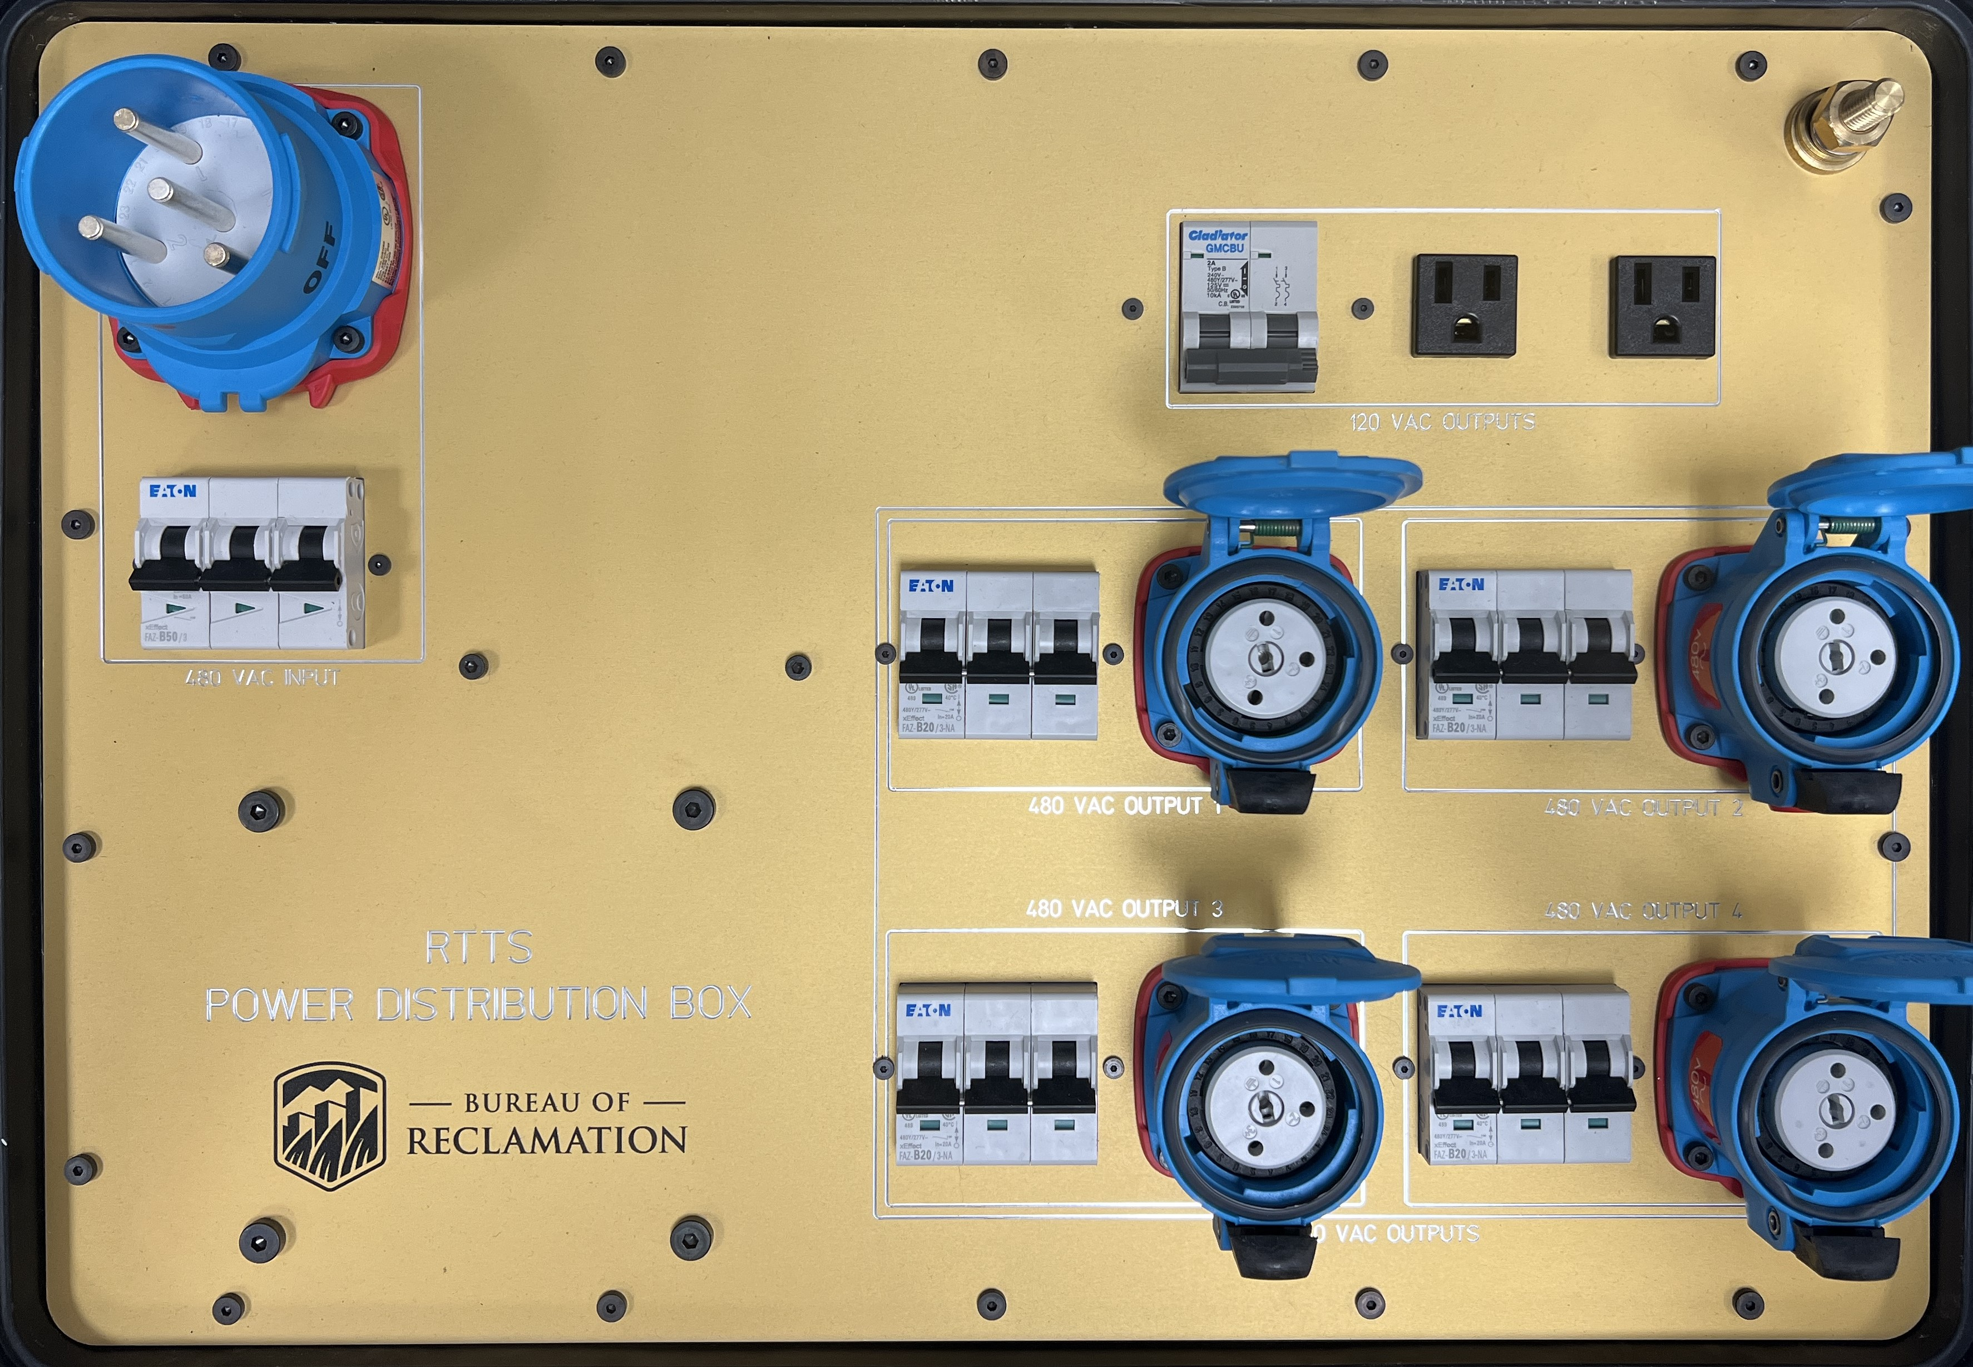
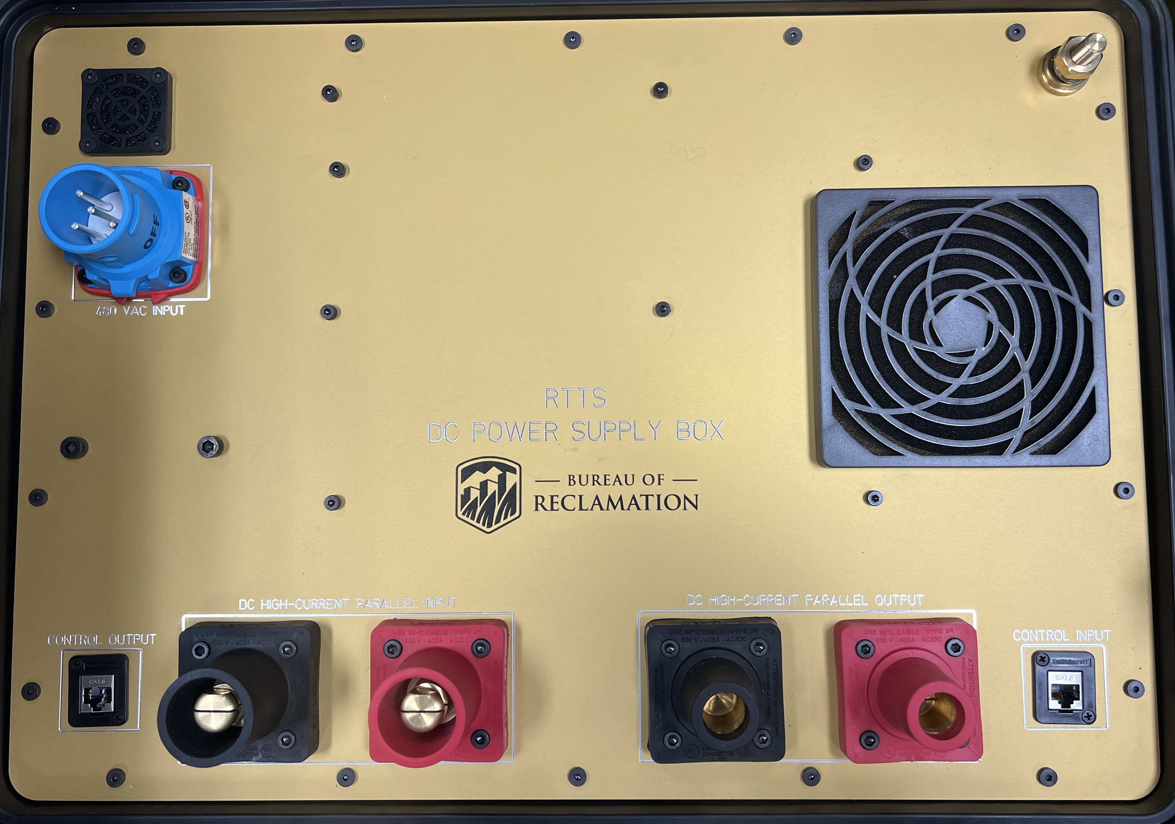

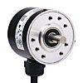
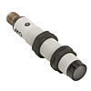
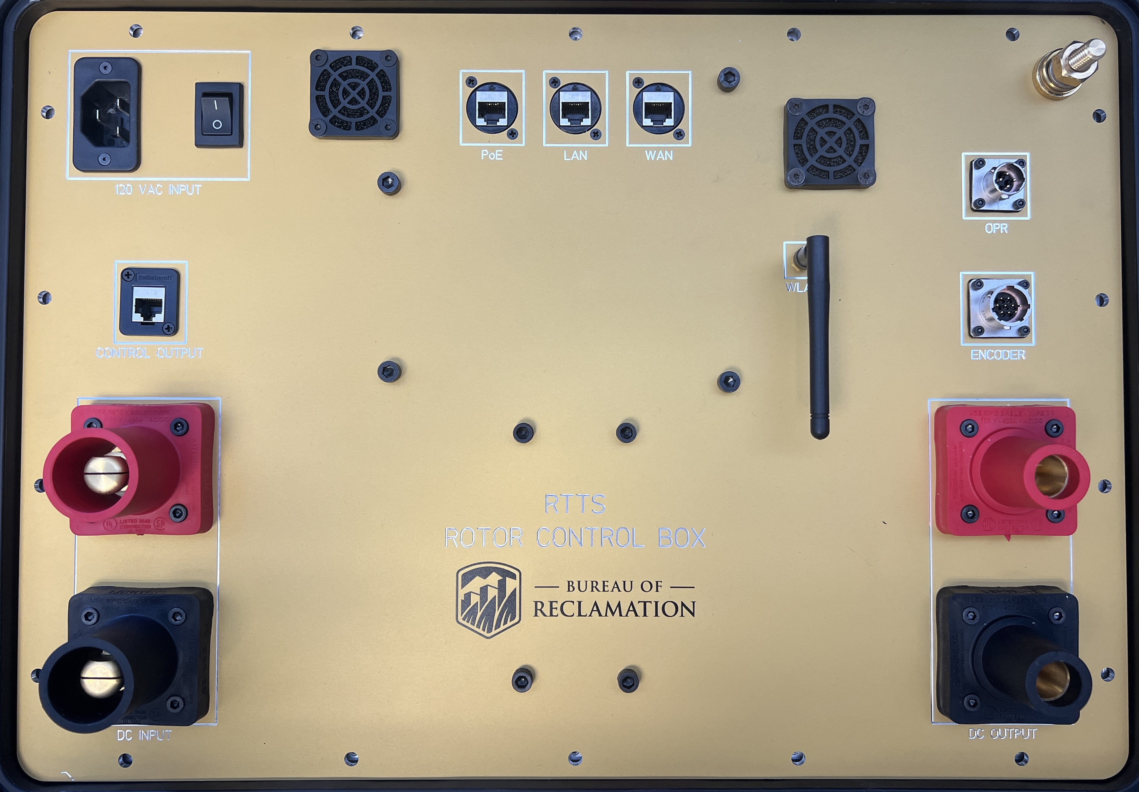
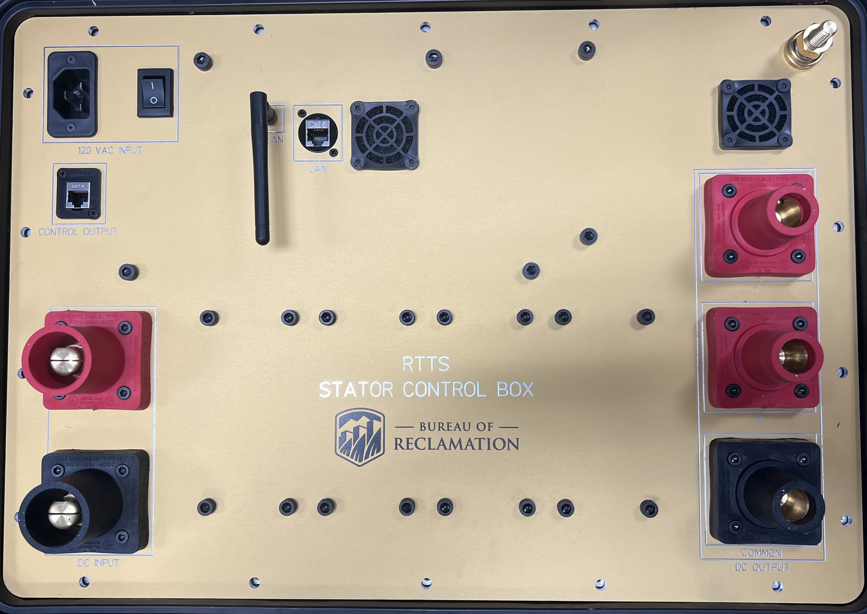

Modular Design (Hardware)
DISTRIBUTION BOX
DISTRIBUTION BOX
STATOR WINDING
DC SUPPLY BOX
DC SUPPLY BOX
DC SUPPLY BOX
DC SUPPLY BOX
DC SUPPLY BOX
DC SUPPLY BOX
DC SUPPLY BOX
DC SUPPLY BOX
ROTOR BOX
STATOR BOX
ROTOR WINDING
Notes:
480 V power

Slide 47
Modular Design (Hardware)
DISTRIBUTION BOX
DISTRIBUTION BOX
STATOR WINDING
DC SUPPLY BOX
DC SUPPLY BOX
DC SUPPLY BOX
DC SUPPLY BOX
DC SUPPLY BOX
DC SUPPLY BOX
DC SUPPLY BOX
DC SUPPLY BOX
ROTOR BOX
STATOR BOX
ROTOR WINDING
Notes:
480 V power

Slide 48
Modular Design (Hardware)
DISTRIBUTION BOX
DISTRIBUTION BOX
STATOR WINDING
DC SUPPLY BOX
DC SUPPLY BOX
DC SUPPLY BOX
DC SUPPLY BOX
DC SUPPLY BOX
DC SUPPLY BOX
DC SUPPLY BOX
DC SUPPLY BOX
ROTOR BOX
STATOR BOX
ROTOR WINDING

Slide 49
Modular Design (Hardware)
DISTRIBUTION BOX
DISTRIBUTION BOX
STATOR WINDING
DC SUPPLY BOX
DC SUPPLY BOX
DC SUPPLY BOX
DC SUPPLY BOX
DC SUPPLY BOX
DC SUPPLY BOX
DC SUPPLY BOX
DC SUPPLY BOX
ROTOR BOX
STATOR BOX
ROTOR WINDING

Slide 50
Modular Design (Hardware)
DISTRIBUTION BOX
DISTRIBUTION BOX
STATOR WINDING
DC SUPPLY BOX
DC SUPPLY BOX
DC SUPPLY BOX
DC SUPPLY BOX
DC SUPPLY BOX
DC SUPPLY BOX
DC SUPPLY BOX
DC SUPPLY BOX
ROTOR BOX
STATOR BOX
ROTOR WINDING

Slide 51
Modular Design (Hardware)
DISTRIBUTION BOX
DISTRIBUTION BOX
STATOR WINDING
DC SUPPLY BOX
DC SUPPLY BOX
DC SUPPLY BOX
DC SUPPLY BOX
DC SUPPLY BOX
DC SUPPLY BOX
DC SUPPLY BOX
DC SUPPLY BOX
ROTOR BOX
STATOR BOX
ROTOR WINDING

Slide 52
Modular Design (Hardware)
DISTRIBUTION BOX
DISTRIBUTION BOX
STATOR WINDING
DC SUPPLY BOX
DC SUPPLY BOX
DC SUPPLY BOX
DC SUPPLY BOX
DC SUPPLY BOX
DC SUPPLY BOX
DC SUPPLY BOX
DC SUPPLY BOX
ROTOR BOX
STATOR BOX
ROTOR WINDING

Slide 53
Modular Design (Hardware)
DISTRIBUTION BOX
DISTRIBUTION BOX
STATOR WINDING
DC SUPPLY BOX
DC SUPPLY BOX
DC SUPPLY BOX
DC SUPPLY BOX
DC SUPPLY BOX
DC SUPPLY BOX
DC SUPPLY BOX
DC SUPPLY BOX
ROTOR BOX
STATOR BOX
ROTOR WINDING
Notes:
OPR = once per revolution. A sensor that detects one revolution of the rotor.
Rotary encoder = a sensor that tracks rotational position

Slide 54
Modular Design (Hardware)
DISTRIBUTION BOX
DISTRIBUTION BOX
STATOR WINDING
DC SUPPLY BOX
DC SUPPLY BOX
DC SUPPLY BOX
DC SUPPLY BOX
DC SUPPLY BOX
DC SUPPLY BOX
DC SUPPLY BOX
DC SUPPLY BOX
ROTOR BOX
STATOR BOX
ROTOR WINDING

Slide 55
Modular Design (Hardware)
DISTRIBUTION BOX
DISTRIBUTION BOX
STATOR WINDING
DC SUPPLY BOX
DC SUPPLY BOX
DC SUPPLY BOX
DC SUPPLY BOX
DC SUPPLY BOX
DC SUPPLY BOX
DC SUPPLY BOX
DC SUPPLY BOX
ROTOR BOX
STATOR BOX
ROTOR WINDING

Slide 56
Modular Design (Hardware)
DISTRIBUTION BOX
DISTRIBUTION BOX
STATOR WINDING
DC SUPPLY BOX
DC SUPPLY BOX
DC SUPPLY BOX
DC SUPPLY BOX
DC SUPPLY BOX
DC SUPPLY BOX
DC SUPPLY BOX
DC SUPPLY BOX
ROTOR BOX
STATOR BOX
ROTOR WINDING

Slide 57
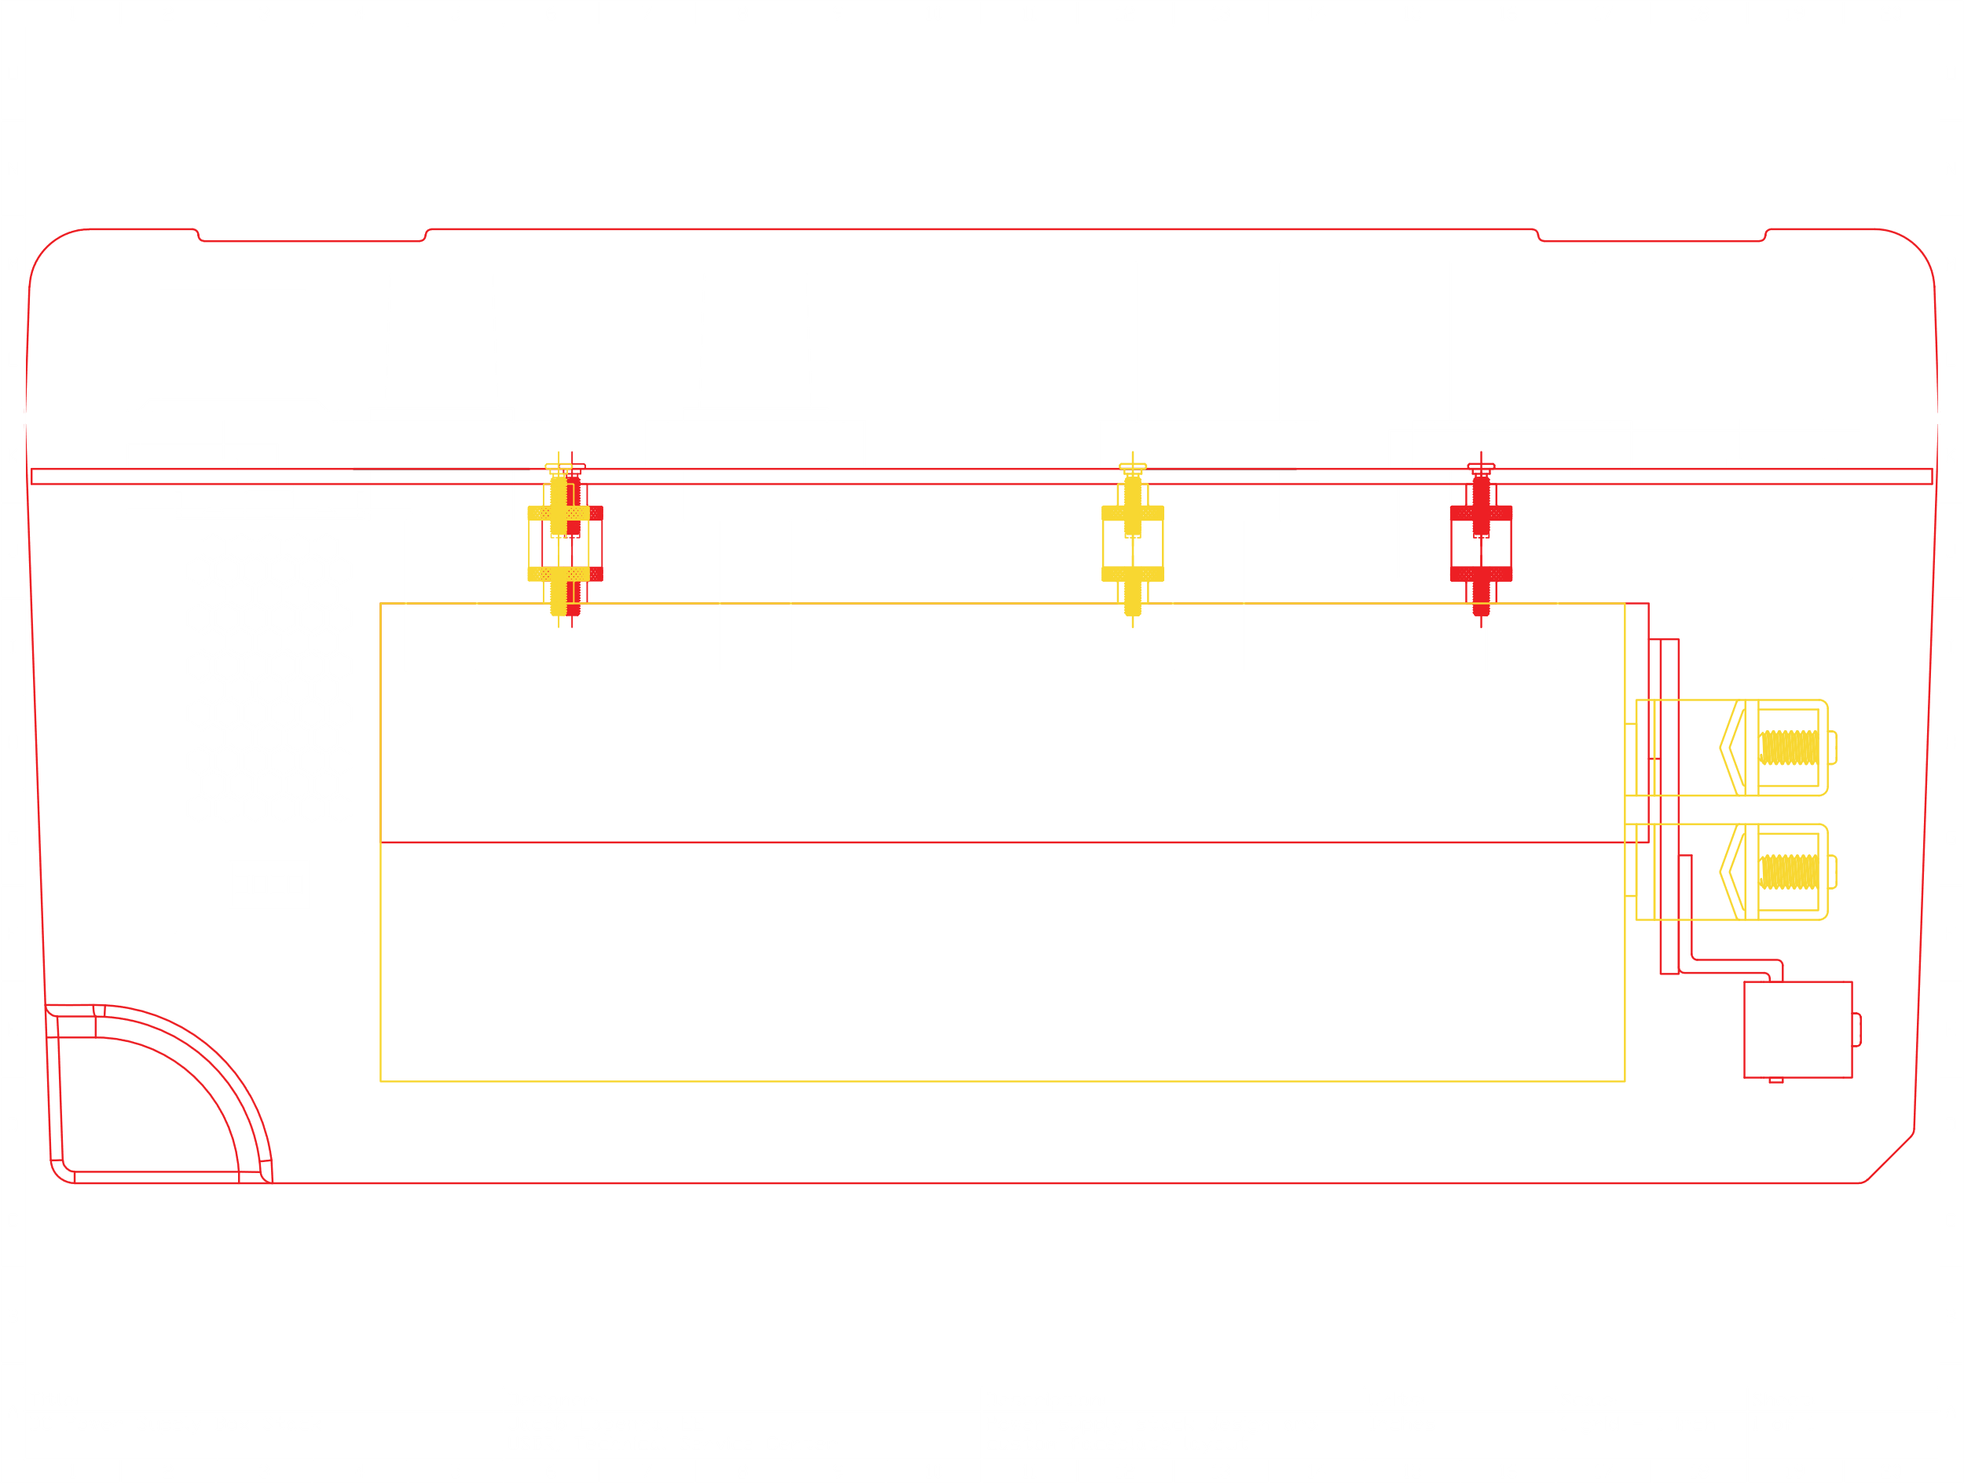
Modular Design (Hardware)
Notes:
McMaster Carr and Automation Direct are great to source components from as they provide a CAD drawing for almost all the products they sell.

Slide 58
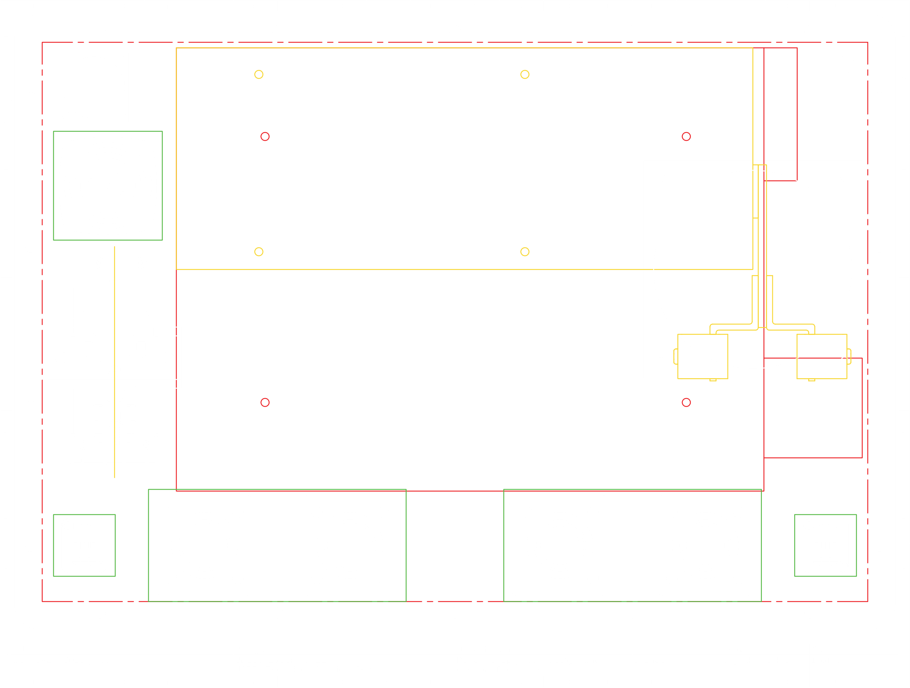
Modular Design (Hardware)
Notes:
Faceplate = the outer plate that the user sees and interacts with. Must be machines to fits all plugs, connectors, fans, etc in a neat and visually appealling way.

Slide 59
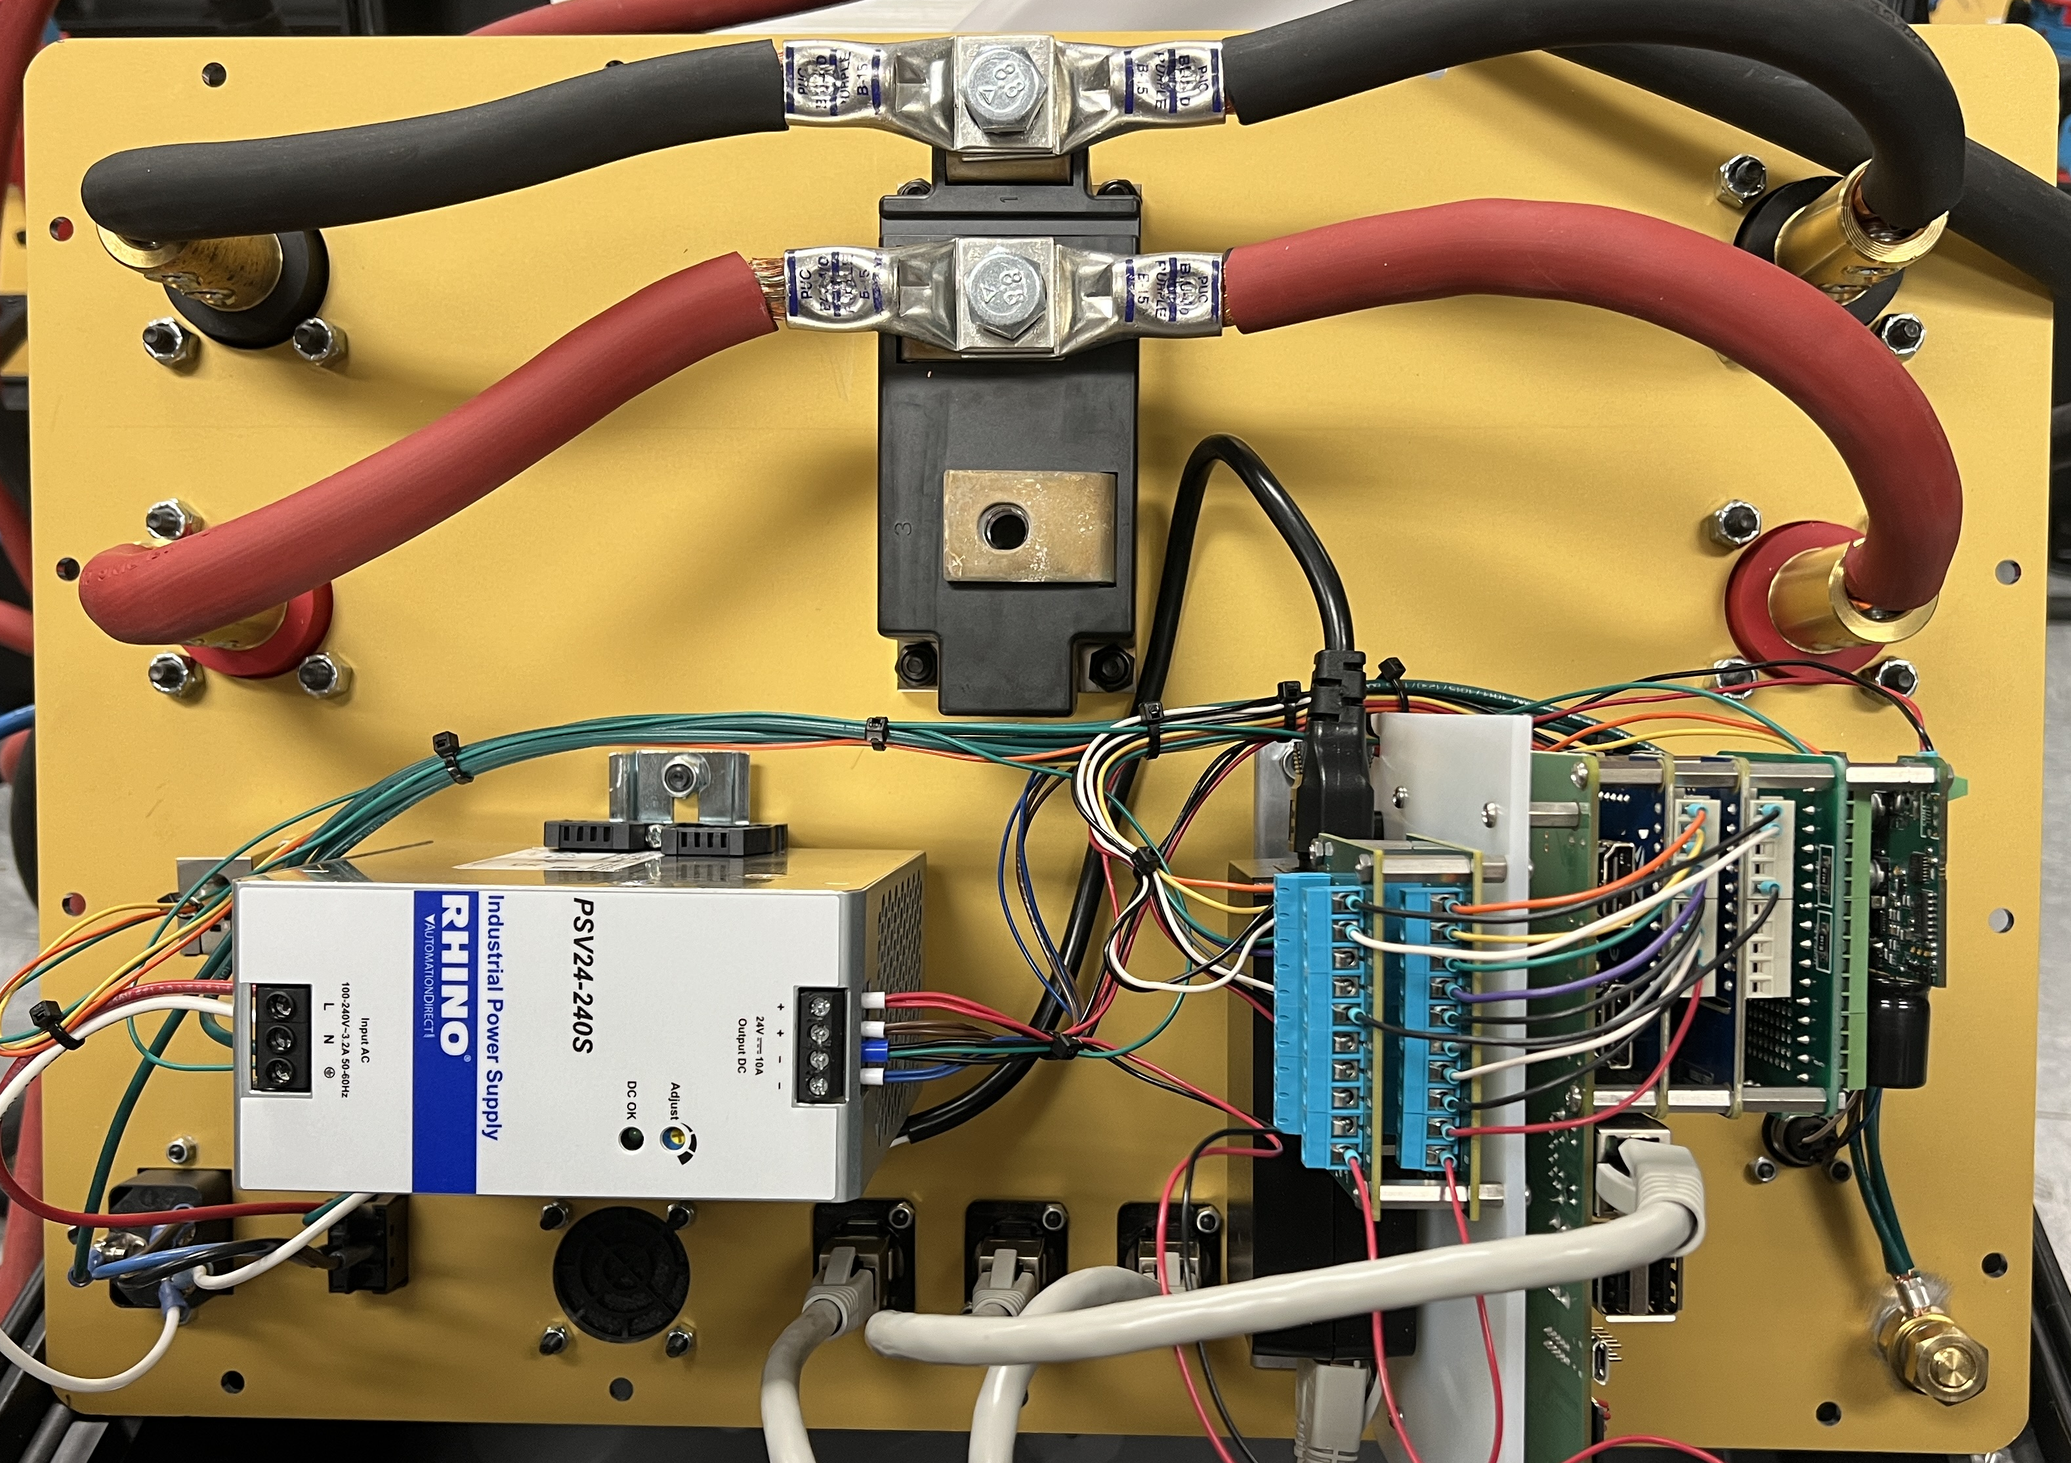
Modular Design (Hardware)
Notes:
Everything is mounted to faceplate for easy maintenance

Slide 60
Modular Design (Software)
Stator Control
Distributed computing
Rotor Control
Redis Connection
Assigned a message queue
Monitors for tasks in queue
Detects event requests
Publishes tasks to message broker
Notes:
Distributed comuting = the same application carrying out computing tasks over distributed hardware

Slide 61
Modular Design (Software)
Stator Control
Distributed computing
Rotor Control
Redis Connection
Assigned a message queue
Monitors for tasks in queue
Detects event requests
Publishes tasks to message broker

Slide 62
Modular Design (Software)
Stator Control
Distributed computing
Rotor Control
Redis Connection
Assigned a message queue
Monitors for tasks in queue
Detects event requests
Publishes tasks to message broker

Slide 63
Modular Design (Software)
Stator Control
Distributed computing
Rotor Control
Redis Connection
Assigned a message queue
Monitors for tasks in queue
Detects event requests
Publishes tasks to message broker
Notes:
Message broker = Redis
Message queue

Slide 64
Modular Design (Software)
Stator Control
Distributed computing
Rotor Control
Redis Connection
Assigned a message queue
Monitors for tasks in queue
Detects event requests
Publishes tasks to message broker

Slide 65
Modular Design (Software)
Stator Control
Distributed computing
Rotor Control
Redis Connection
Assigned a message queue
Monitors for tasks in queue
Detects event requests
Publishes tasks to message broker

Slide 66
Modular Design (Software)
Stator Control
Distributed computing
Rotor Control
Redis Connection
Assigned a message queue
Monitors for tasks in queue
Detects event requests
Publishes tasks to message broker

Slide 67
Modular Design (Software)
Stator Control
Distributed computing
Air Gap Measurement Control
Rotor Control
Partial Discharge Mapping Control
And more…

Slide 68
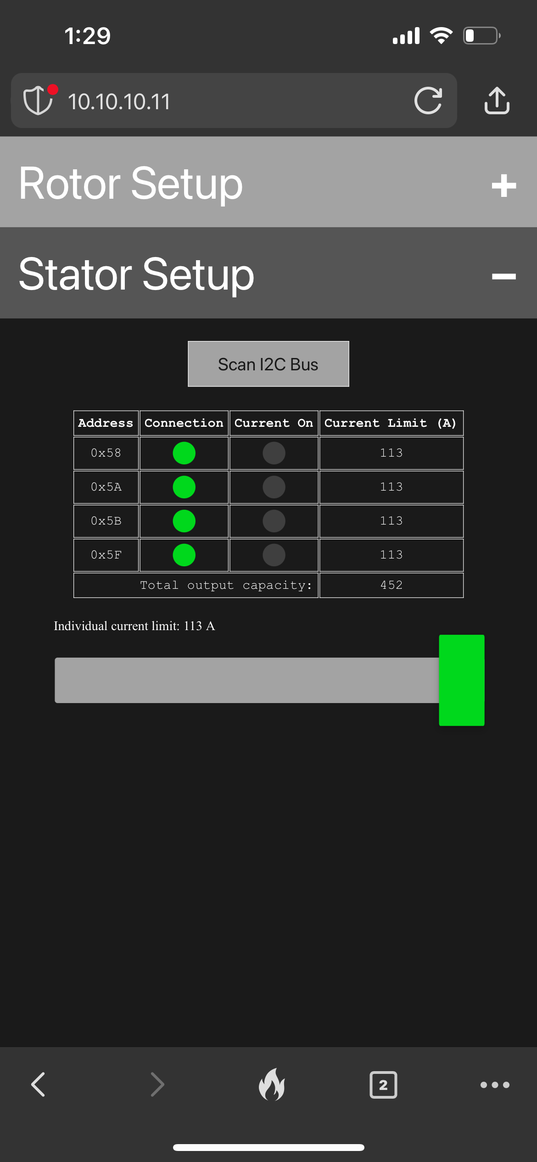
Event Example: Forward Rotation

Slide 69
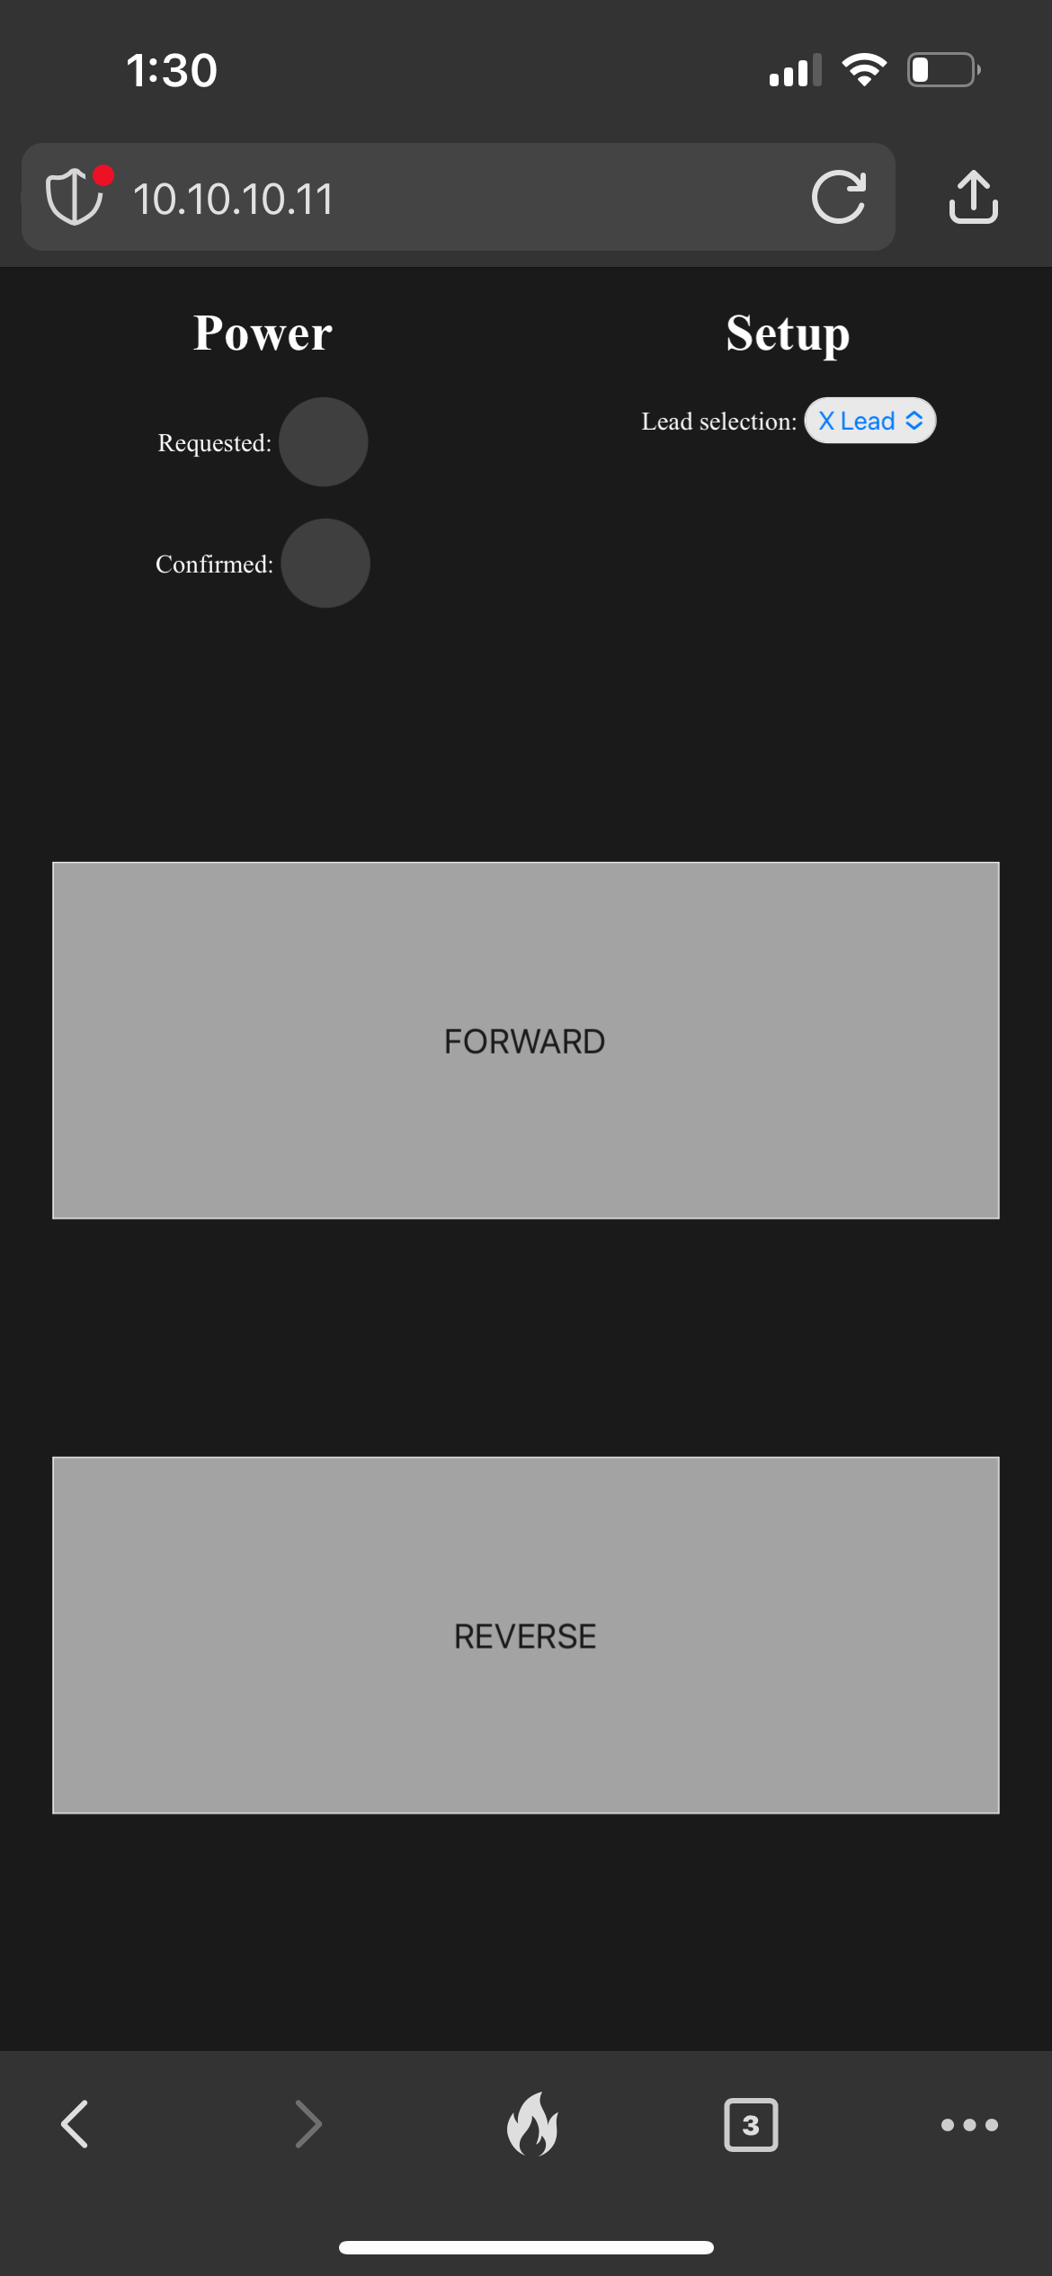
Event Example: Forward Rotation

Slide 70
Event Example: Forward Rotation

Slide 71
Event Example: Forward Rotation

Slide 72



Event Example: Forward Rotation
user
rotor
stator
rtts/rotor/templates/manual_turn.html
<!DOCTYPE html>
<html>
<head> <title>RTTS Manual Turning</title>
<script src="{{ url_for('static', filename='js/socket.io.min.js') }}"></script>
... </head>
<body> ...
<button id="forward_button">FORWARD</button> ... <script type="module" src="{{ url_for('static', filename='js/manual_turn_main.js') }}">
</script> </body>
</html>

Slide 73
Event Example: Forward Rotation
user
rotor
stator
rtts/rotor/templates/manual_turn.html
<!DOCTYPE html>
<html>
<head> <title>RTTS Manual Turning</title>
<script src="{{ url_for('static', filename='js/socket.io.min.js') }}"></script>
... </head>
<body> ...
<button id="forward_button">FORWARD</button> ... <script type="module" src="{{ url_for('static', filename='js/manual_turn_main.js') }}">
</script> </body>
</html>

Slide 74
Event Example: Forward Rotation
user
rotor
stator
rtts/rotor/static/js/manual_turn_main.js
...
forward_button.ontouchstart = function(event) {
current_on(event, this, events.MANUAL_TURNING.DIRECTION.FORWARD, lead);
}
...
function current_on(event, element, direction, lead) {
// button and request light gets styled here...
if (lead !== null) {
socket.emit(
events.MANUAL_TURNING.TURN_ON,
{"direction" : direction, "lead" : lead}
);
}
}
...

Slide 75
Event Example: Forward Rotation
user
rotor
stator
rtts/rotor/static/js/manual_turn_main.js
...
forward_button.ontouchstart = function(event) {
current_on(event, this, events.MANUAL_TURNING.DIRECTION.FORWARD, lead);
}
...
function current_on(event, element, direction, lead) {
// button and request light gets styled here...
if (lead !== null) {
socket.emit(
events.MANUAL_TURNING.TURN_ON,
{"direction" : direction, "lead" : lead}
);
}
}
...

Slide 76
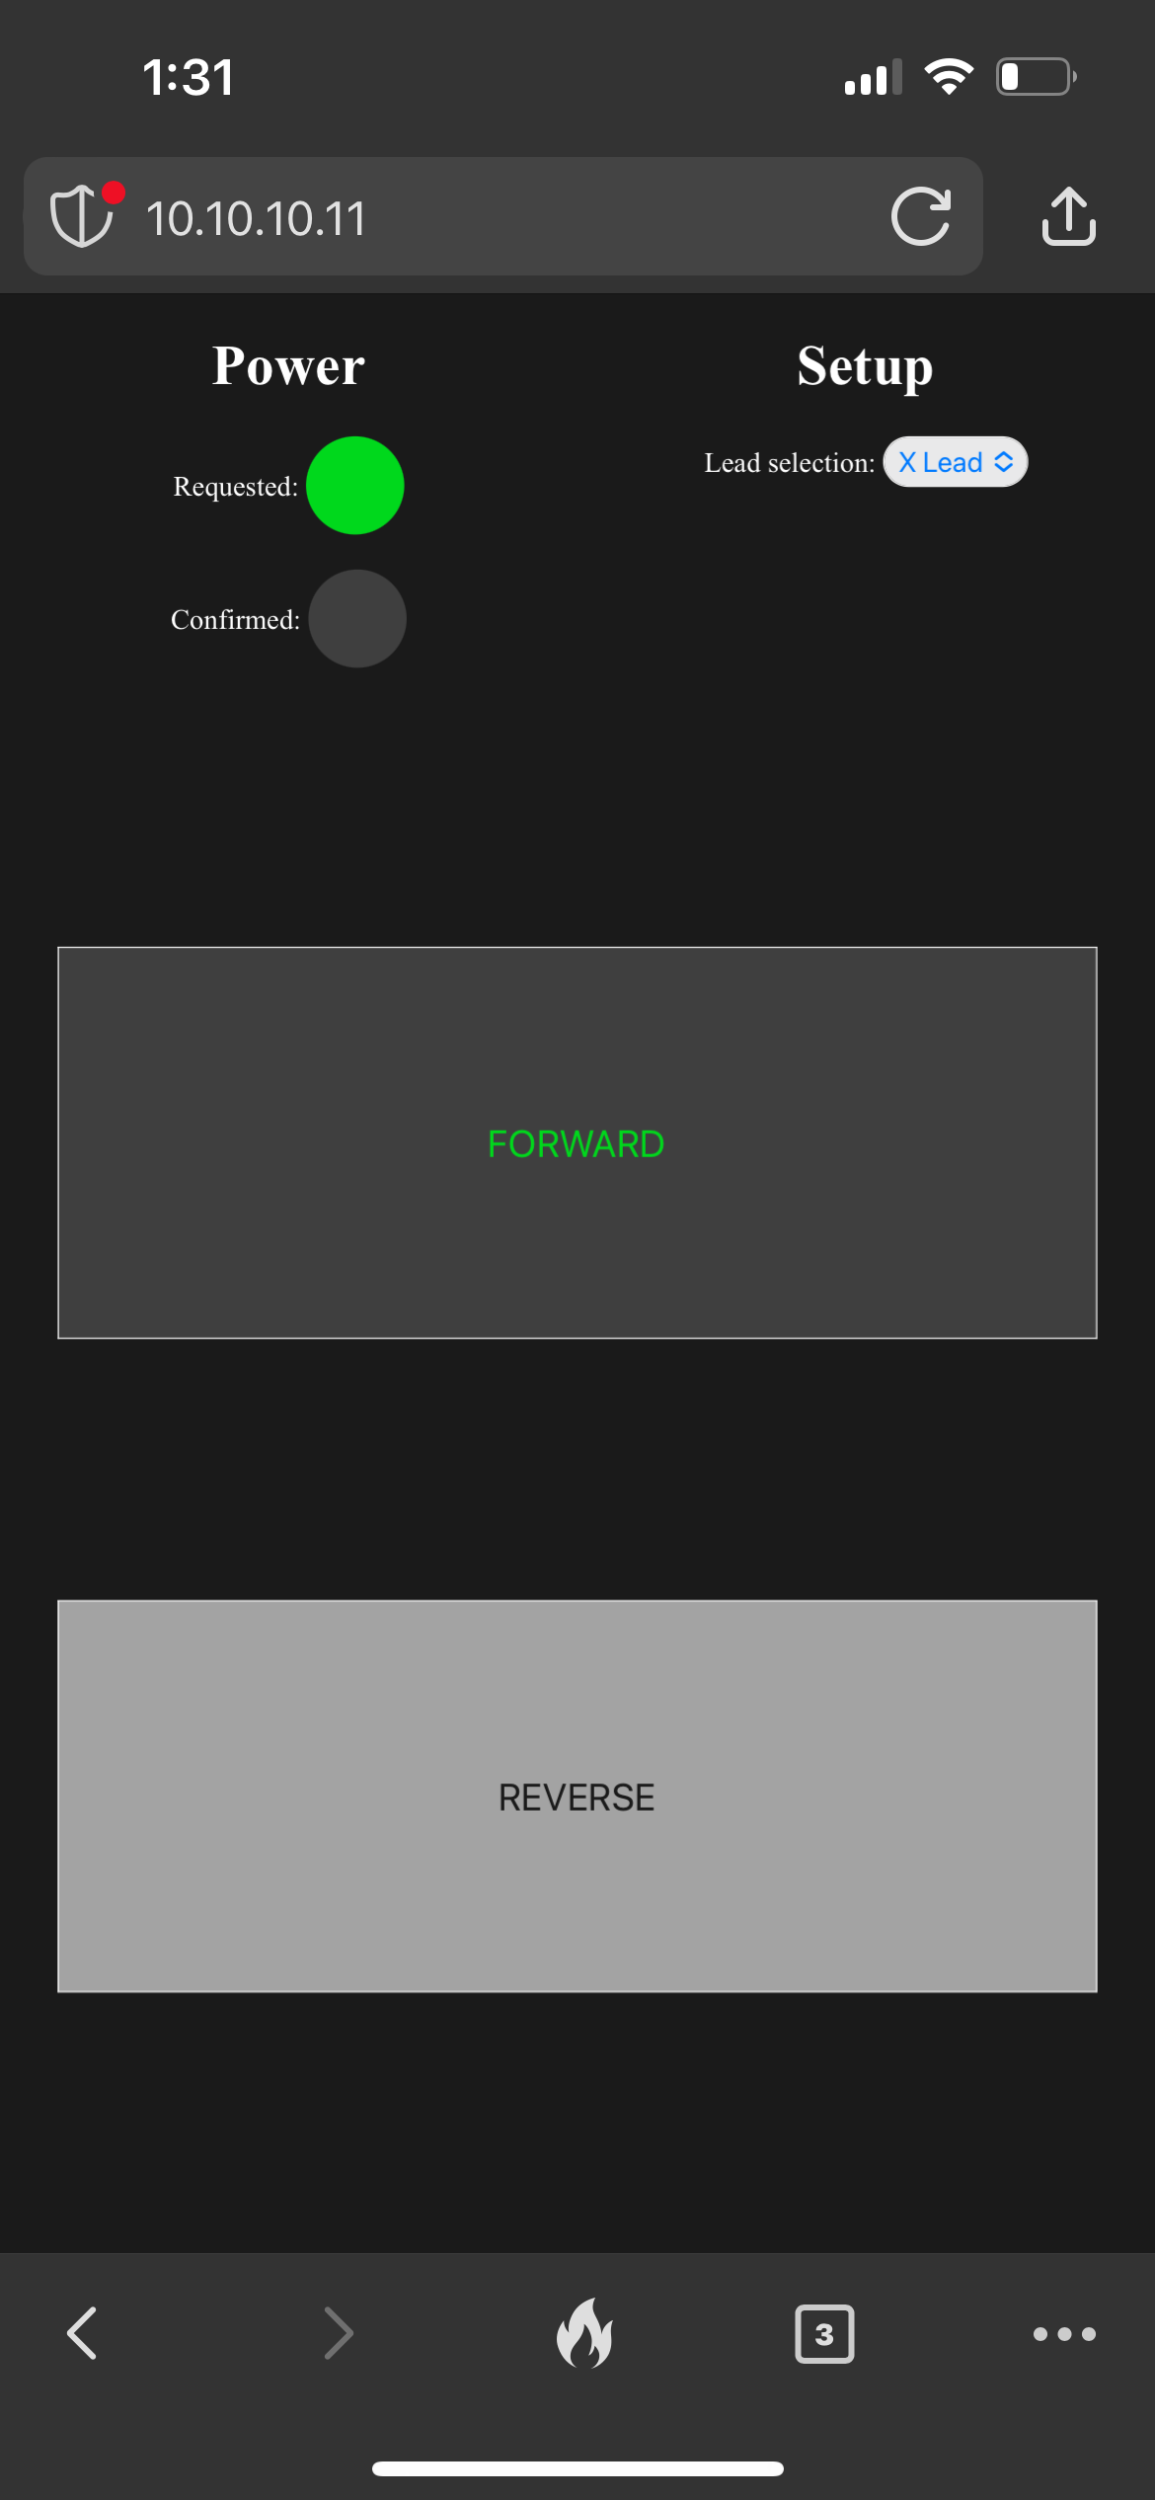
Event Example: Forward Rotation

Slide 77
Event Example: Forward Rotation
user
rotor
stator
rtts/rotor/static/js/manual_turn_main.js
...
forward_button.ontouchstart = function(event) {
current_on(event, this, events.MANUAL_TURNING.DIRECTION.FORWARD, lead);
}
...
function current_on(event, element, direction, lead) {
// button and request light gets styled here...
if (lead !== null) {
socket.emit(
events.MANUAL_TURNING.TURN_ON,
{"direction" : direction, "lead" : lead}
);
}
}
...

Slide 78

Event Example: Forward Rotation
user
rotor
stator
rtts/rotor/events.py
@socketio.on(event.names.MANUAL_TURNING.TURN_ON)
def request_current_on(requested_state: dict):
lead = requested_state["lead"]
if lead:
current_amps = int(cache_conn.get(CacheKeys.STATOR_CURRENT_LIMIT))
cel.send_task(
"rtts.stator.turn_on",
args=[requested_state["direction"], lead, current_amps]
)

Slide 79
Event Example: Forward Rotation
user
rotor
stator
rtts/rotor/events.py
@socketio.on(event.names.MANUAL_TURNING.TURN_ON)
def request_current_on(requested_state: dict):
lead = requested_state["lead"]
if lead:
current_amps = int(cache_conn.get(CacheKeys.STATOR_CURRENT_LIMIT))
cel.send_task(
"rtts.stator.turn_on",
args=[requested_state["direction"], lead, current_amps]
)

Slide 80

Event Example: Forward Rotation
user
rotor
stator
/var/log/celery/celery.log
[2024-04-19 13:32:29,292: INFO/MainProcess] Task rtts.stator.turn_on [<event ID here>] received

Slide 81
Event Example: Forward Rotation
user
rotor
stator
rtts/stator/tasks.py
@cel.task(name="rtts.stator.turn_on")
def turn_on(direction: str, lead: str):
if direction == event.names.MANUAL_TURNING.DIRECTION.FORWARD:
if lead == event.names.MANUAL_TURNING.LEAD.X:
SCRs.X_FORWARD.fire()
elif lead == event.names.MANUAL_TURNING.LEAD.Y:
SCRs.Y_FORWARD.fire()
elif direction == event.names.MANUAL_TURNING.DIRECTION.REVERSE:
...
on_states = bus.set_current_limits(current_amps)
socketio.emit(event.names.MANUAL_TURNING.CONFIRMED_ON, on_states)

Slide 82
Event Example: Forward Rotation
user
rotor
stator
rtts/stator/tasks.py
@cel.task(name="rtts.stator.turn_on")
def turn_on(direction: str, lead: str):
if direction == event.names.MANUAL_TURNING.DIRECTION.FORWARD:
if lead == event.names.MANUAL_TURNING.LEAD.X:
SCRs.X_FORWARD.fire()
elif lead == event.names.MANUAL_TURNING.LEAD.Y:
SCRs.Y_FORWARD.fire()
elif direction == event.names.MANUAL_TURNING.DIRECTION.REVERSE:
...
on_states = bus.set_current_limits(current_amps)
socketio.emit(event.names.MANUAL_TURNING.CONFIRMED_ON, on_states)

Slide 83
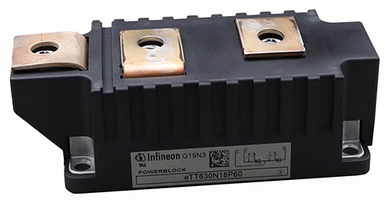
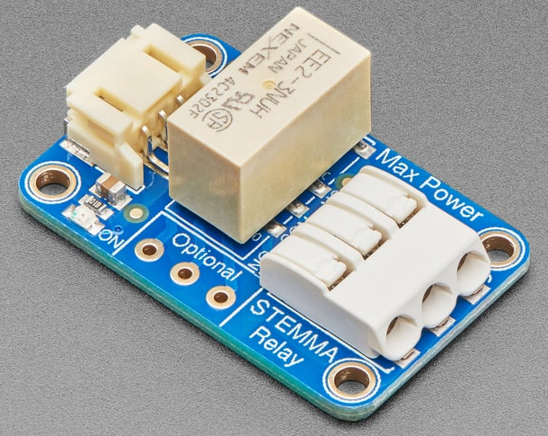
Event Example: Forward Rotation
user
rotor
stator
SCR Circuit
GPIO 5
SCR Firing Board
Relay
SCRs

Slide 84
Event Example: Forward Rotation
user
rotor
stator
SCR Circuit
GPIO 5
SCR Firing Board
Relay
SCRs

Slide 85
Event Example: Forward Rotation
user
rotor
stator
SCR Circuit
GPIO 5
SCR Firing Board
Relay
SCRs

Slide 86
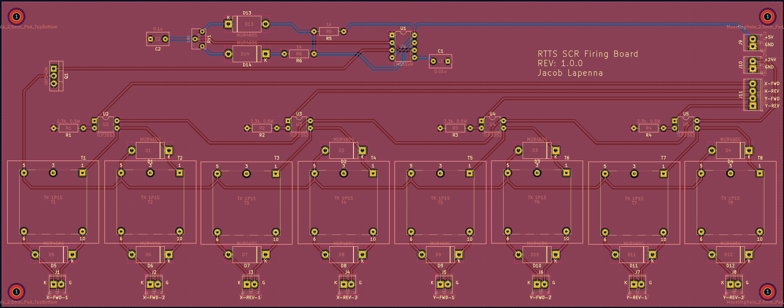
Event Example: Forward Rotation
user
rotor
stator
SCR Circuit
Notes:
Optical isolation relay

Slide 87
Event Example: Forward Rotation
user
rotor
stator
SCR Circuit
Notes:
24 VDC through primary side of pulse transformer to a mossfet

Slide 88
Event Example: Forward Rotation
user
rotor
stator
SCR Circuit
Notes:
Mosfet is pulsed to control ground side of primary side of pulse transformer.

Slide 89
Event Example: Forward Rotation
user
rotor
stator
SCR Circuit
Notes:
Pulse is sent to SCR to reduce gat circuit power consumption. High frequency is used so that when anode is biased, the next gate pulse fires the SCR.

Slide 90
Event Example: Forward Rotation
user
rotor
stator
SCR Circuit
GPIO 5
SCR Firing Board
Relay
SCRs
Notes:
GPIO = general purpose input and output
SCR = silicon-controlled rectifier. Four-layer silicon switching to control very high currents with minimal power. It’s like a very high-current transistor (though transistors are 3-layer silicon).

Slide 91
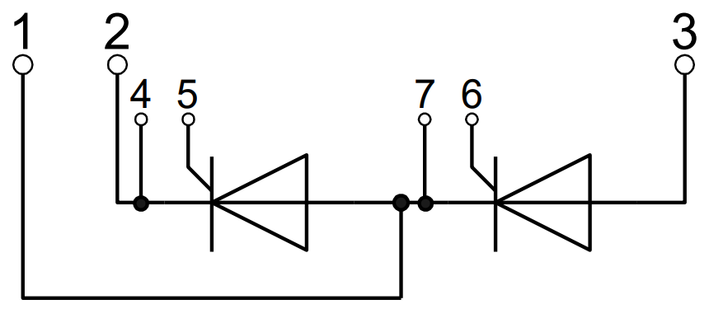
Event Example: Forward Rotation
user
rotor
stator
SCR Circuit

Slide 92
Event Example: Forward Rotation
user
rotor
stator
SCR Circuit

Slide 93
Event Example: Forward Rotation
user
rotor
stator
SCR Circuit

Slide 94
Event Example: Forward Rotation
user
rotor
stator
SCR Circuit

Slide 95
Event Example: Forward Rotation
user
rotor
stator
SCR Circuit

Slide 96
Event Example: Forward Rotation
user
rotor
stator
rtts/stator/tasks.py
@cel.task(name="rtts.stator.turn_on")
def turn_on(direction: str, lead: str):
if direction == event.names.MANUAL_TURNING.DIRECTION.FORWARD:
if lead == event.names.MANUAL_TURNING.LEAD.X:
SCRs.X_FORWARD.fire()
elif lead == event.names.MANUAL_TURNING.LEAD.Y:
SCRs.Y_FORWARD.fire()
elif direction == event.names.MANUAL_TURNING.DIRECTION.REVERSE:
...
on_states = bus.set_current_limits(current_amps)
socketio.emit(event.names.MANUAL_TURNING.CONFIRMED_ON, on_states)

Slide 97
Event Example: Forward Rotation
user
rotor
stator
rtts/stator/tasks.py
@cel.task(name="rtts.stator.turn_on")
def turn_on(direction: str, lead: str):
if direction == event.names.MANUAL_TURNING.DIRECTION.FORWARD:
if lead == event.names.MANUAL_TURNING.LEAD.X:
SCRs.X_FORWARD.fire()
elif lead == event.names.MANUAL_TURNING.LEAD.Y:
SCRs.Y_FORWARD.fire()
elif direction == event.names.MANUAL_TURNING.DIRECTION.REVERSE:
...
on_states = bus.set_current_limits(current_amps)
socketio.emit(event.names.MANUAL_TURNING.CONFIRMED_ON, on_states)

Slide 98
Event Example: Forward Rotation
user
rotor
stator
rtts/rotor/static/js/manual_turn_main.js
...
socket.on(events.MANUAL_TURNING.CONFIRMED_ON, function(on_states) {
confirm_light.style.backgroundColor = confirm_color;
});
...

Slide 99
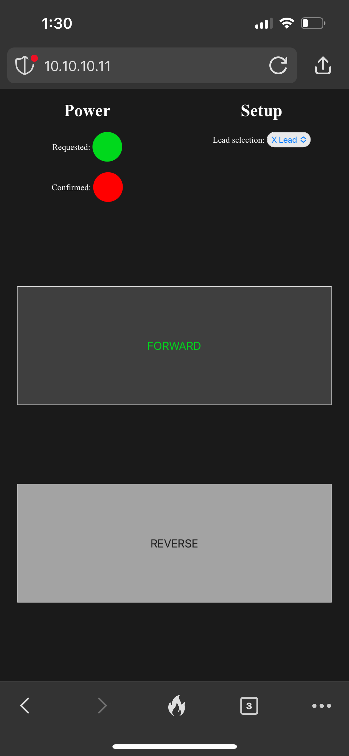
Event Example: Forward Rotation

Slide 100

Event Example: Forward Rotation

Slide 101
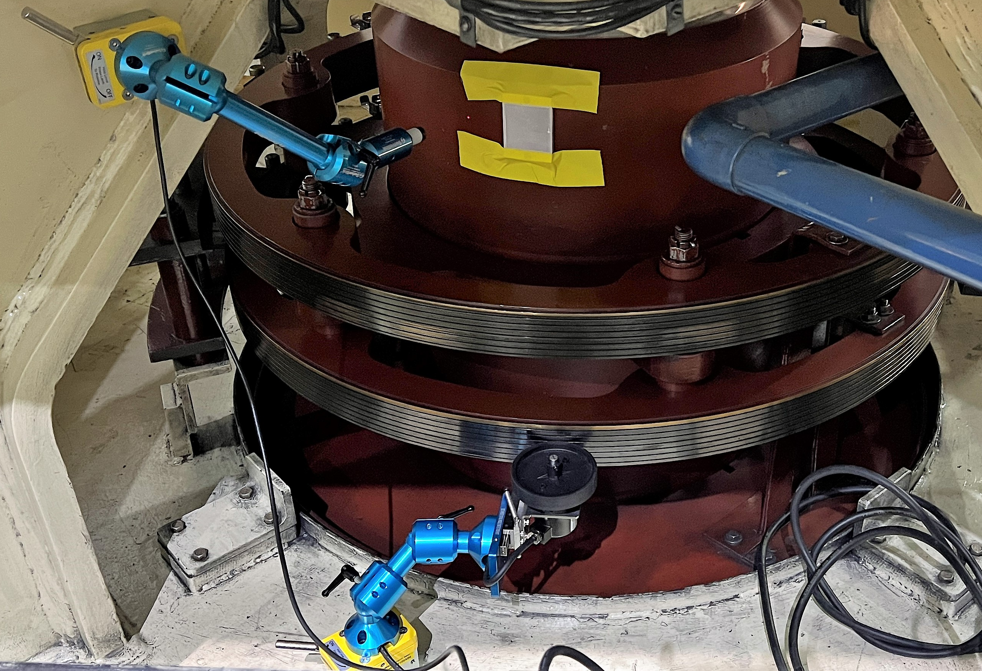
Sensing

Slide 102
Sensing: Once per Revolution (OPR)

Slide 103
Sensing: Rotary Encoder
Notes:
Slip ring = the metal ring that carbon brushes slip against to transfer current to the turning rotor’s electromagnets
Slip ring circumference is unknow. Drive ratio is different for every machine.

Slide 104
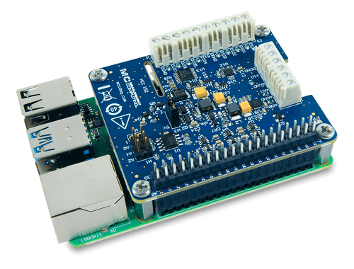

Sensing
MCC 152 DAQ HAT
8 channel digital I/O
Stack up to 8
Python daqhats API
Notes:
MCC 152 = measurement computing (now Digilent) product to detect digital signals
DAQ = data acquisition
HAT = Hardware Attached on Top. A device that can plug directly into the Raspberry Pi’s GPIO header and provide some extra functionality. In this case, digital signal acquisition.

Slide 105
Sensing
MCC 152 DAQ HAT
8 channel digital I/O
Stack up to 8
Python daqhats API

Slide 106
Sensing
MCC 152 DAQ HAT
8 channel digital I/O
Stack up to 8
Python daqhats API

Slide 107

Sensing
MCC 152 DAQ HAT
8 channel digital I/O
Stack up to 8
Python daqhats API

Slide 108
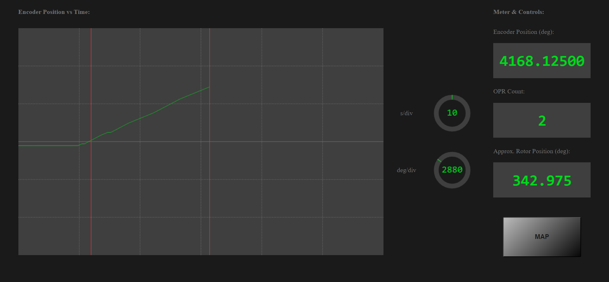
Sensing: Determining Drive Ratio

Slide 109
Future Work
N
S
S
N
I
N
S
Automation
Circumference tool
Partial discharge mapping
Air gap measurement
S
N
N
S
S
N
N
S
S
N

Slide 110
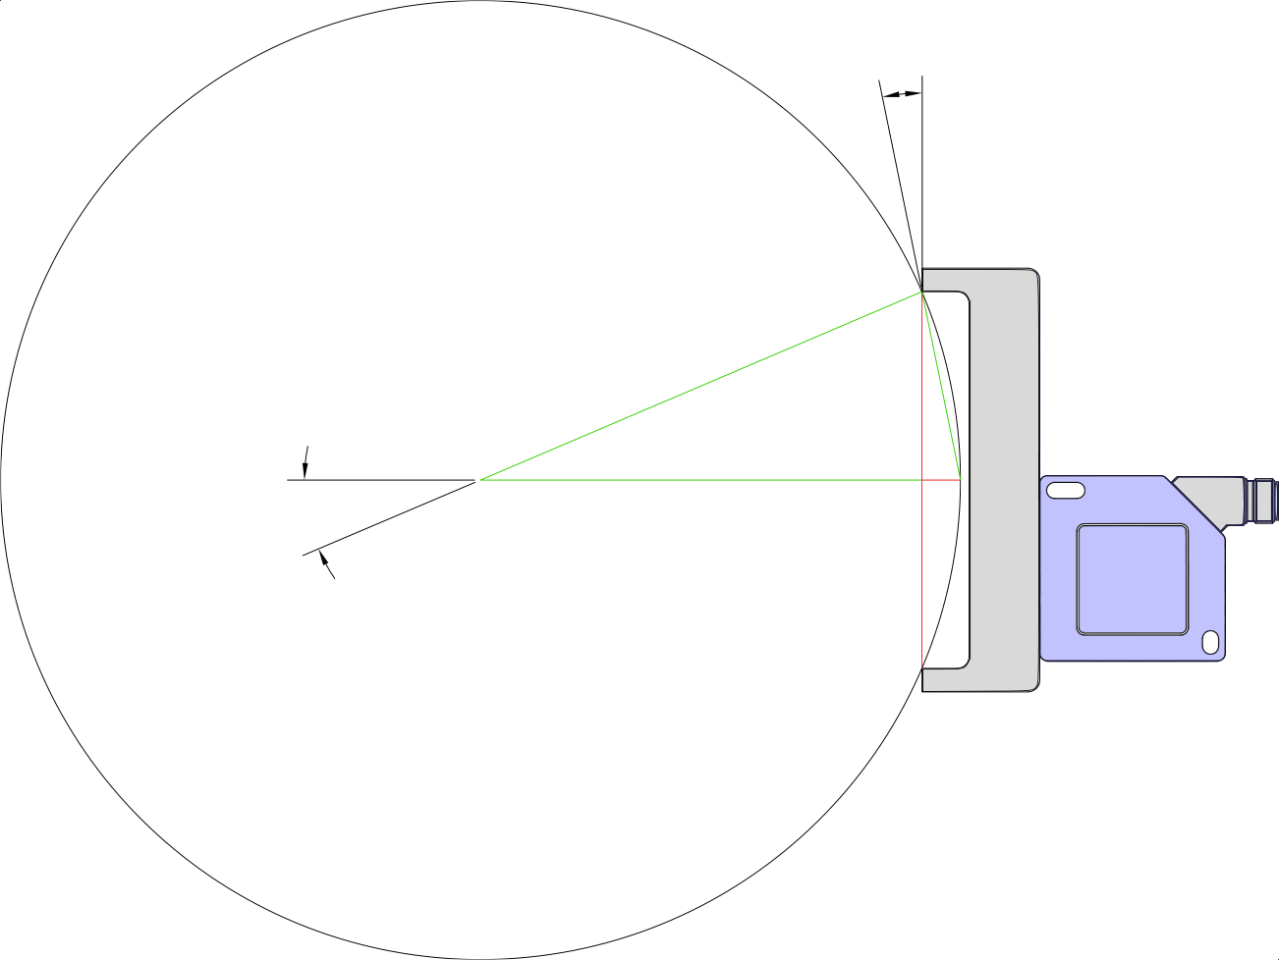



Future Work
α
Automation
Circumference tool
Partial discharge mapping
Air gap measurement
$$r$$
$$l$$
θ
$$D$$

Slide 111

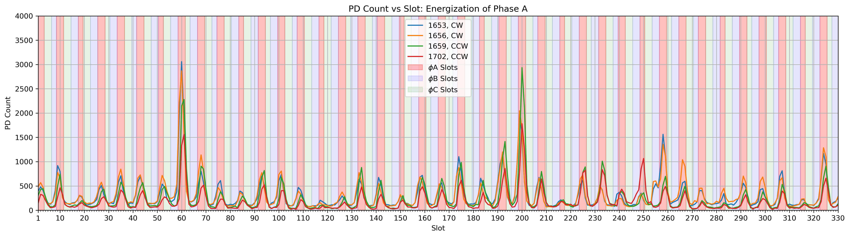
Future Work
Automation
Circumference tool
Partial discharge mapping
Air gap measurement
More Info
Notes:
Partial Discharge = ionization of micro-voids in electrical insulation.
When the stator winding is manufactured, micro bubbles can be trapped in the epoxy. These micro-bubbles represent a discrete change in capacitance across the insulation. This can cause them to ionize when expose to high-voltage. This can be detect with a near-field communication (NFC) antenna. Stick an NFC antenna on a rotor pole, turn the rotor while recording antenna signal and position to map activity throughout stator winding. When trended, this can give insight into extent of damage and cost of repair.

Slide 112
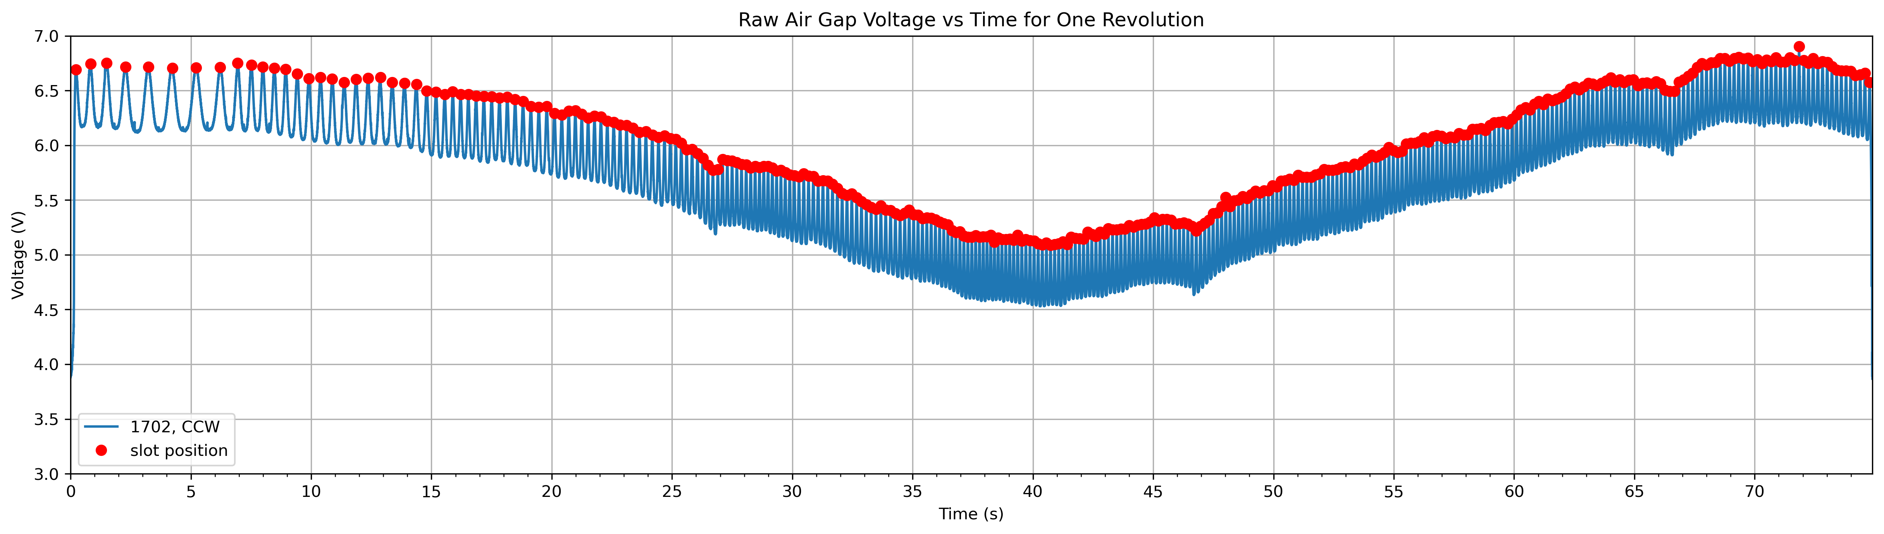
Future Work
Automation
Circumference tool
Partial discharge mapping
Air gap measurement
Notes:
Capacitive proximity probes stuck to rotor pole. This measures distance from pole face to stator. It measures close for each stator core tooth and far for each winding slot. Before, a peak detection algorithm was used in post processing to determine air-gap. Now, position of the probe can simply be recorded as the rotor turns and air gap plotted vs position directly.

Slide 113
Conclusions
IT
OT
Notes:
The line between IT (Information Technology) and OT (Operational Technology) is blurring more and more. We need to facilitate edge computing, real time remote monitoring, and ever more complex computing. We want centralized data to train and learn from. All this required more than ladder logic. This require multidisciplinary teams of software and hardware engineers creating innovative automation and using open source in novel ways.

Slide 114
Questions?
LinkedIn
Email (burner)

